Slide 1
SYRACUSE AND BEYOND Joshua Goldberg Syracuse University
PITP
September 1, 2017

Slide 2
Outline
1 Syracuse
i. Quantum Gravity
ii. Conservation Laws
iii. Equations of Motion
iv. Gravitational Radiation
2 Beyond
I. Introduction
ii. MOND

Slide 3
References:
Thibault Damour, The Problem of Motion in General Relativity: A Century Assessment,
delivered at A Century of General Relativity, Berlin (November 30-December 6, 2015)
Peter Havas, The Early History of the “Problem of Motion” in General Relativity”
In Einstein and the History of General Relativity, Birkhauser (1989), eds Don Howard and John Stachel

Slide 4
Scalar Density Lagrangian
L = √-g R = √g g  g  √gg  g
Note that the divergence term is the only place where second derivatives occur so that the field equations are of the second order.

Slide 5
Scalar Density Lagrangian
L = √g R = √g g  g  √gg  g
Under coordinate mapping
L  L
which ultimately leads to Einstein equations as
√g G  U  t  8 P,

Slide 6
Bianchi Identity
U ≡ 0  (√g G + t) ≡ 0
when field equations are satisfied
(8P + t)  0

Slide 7
Linearization
√-g g =  + ,
Linearized equations
₀U, = 8P + NL

Slide 8
Slow Motion
₀U^{s},_{s} = 8P + NL + L_{t}
Where L_{t} contains time derivatives from the linear terms.
For n, there is an integrability condition
[8P^{s} + NL + L_{t}], _{s} = 0.

Slide 10
Newtonian Gravity
V²/r = GM/r²  V  1/r^{1/2}.

Slide 11
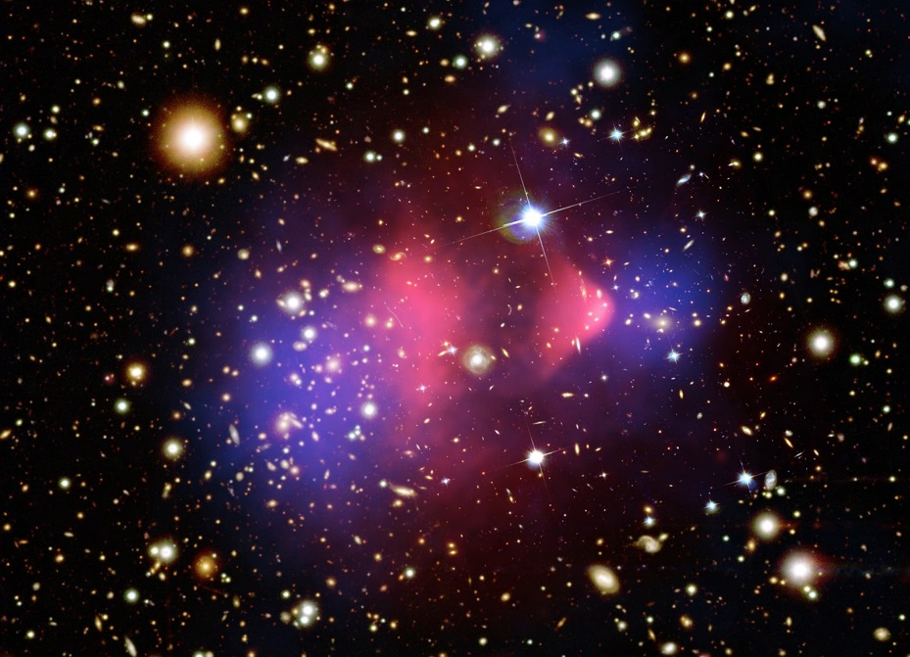
Bullet Galaxies

Slide 12
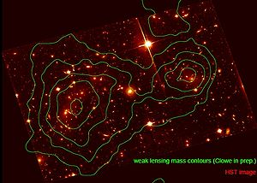
Bullet Galaxies

Slide 13
Tully Fisher Relation
V⁴  L and since
L  M,
V⁴  M.
Above Newtonian argument implies
V²  M.
Adding dark matter does not resolve this problem.

Slide 14
MOND
a (x) = GM/r² e,
(x) = 1, x>>1; (x) = x, x<<1
x = a/a_{0.}
a₀  2x10⁻⁸ cm/sec²
cH₀ = 5x10⁻⁸ cm/sec² , H₀ = 50 km/sec/Mpc

Slide 15
MOND
a² = (GMa₀)/r², a/a_{0.} << 1
For the circular orbits of spiral galaxies,
V_{M}⁴ = Gma_{o}
V⁴  L  M , M the enclosed mass.
Similarly, Milgram finds a limiting bending angle for lensing:
_{M}   V_{M}⁴/c⁴.

Slide 16
Non Relativistic Model
L = -  a₀²/8GF▼ ²/a₀² +   d³x
▼·▼ ²/a₀² ▼ = 4G , x = F’x
Replace the rhs with the Laplacean of _{N} and one finds a first integral
▼ ²/a₀² ▼ = ▼_{N} + ▼ X h.

Slide 17
Relativistic Model: TeVeS
Beckinstein introduces a physical metric
g = e^{-}g + UU - e UU

Slide 18
LAGRANGIAN
S_{g} = 1/16G√-g g R d⁴x
S_{s} = -1/2√-g² g - U U , , + 1/2 Gl⁻²⁴F(kG²) d⁴x
S_{v} = K/(32G) √-g g g U[, U[, - 2/K (g U U + 1) d⁴x
S_{m} = L(g, f, ………….) d⁴x

