Slide 1
From Mars to the Multiverse
Martin Rees
UBC
September 1st, 2017

Slide 2
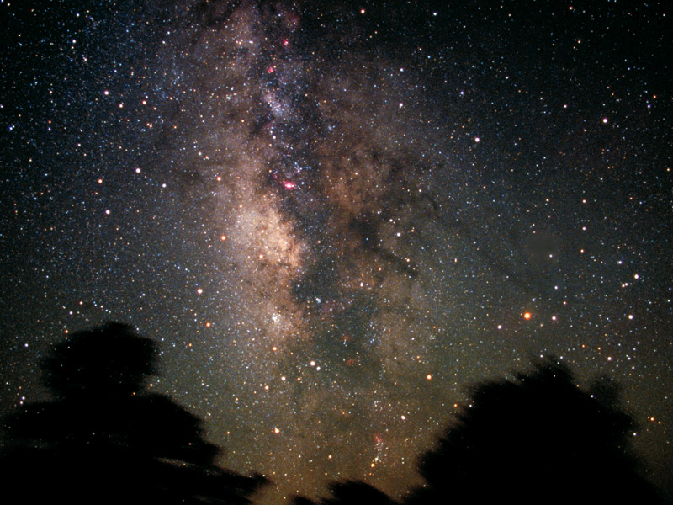
Notes:
Image from HST site 1999-30-e

Slide 3
WHY DO ASTRONOMY?
What is out there? Cosmic exploration.
Interpreting phenomena in terms of known (and perhaps ‘new’) physics.
How, from a ‘simple beginning’, did our Universe evolve into its present complexity (stars, planets, people)?
Can we understand, at a deeper level, why our Universe is the way it is?

Slide 4


Slide 5
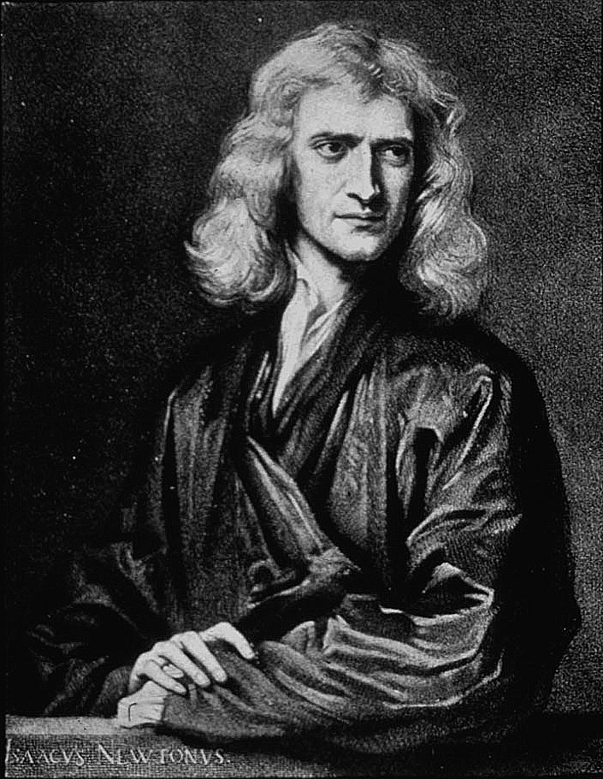

Slide 6
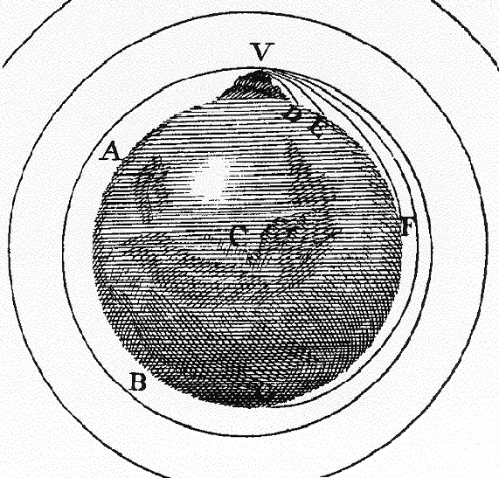

Slide 7
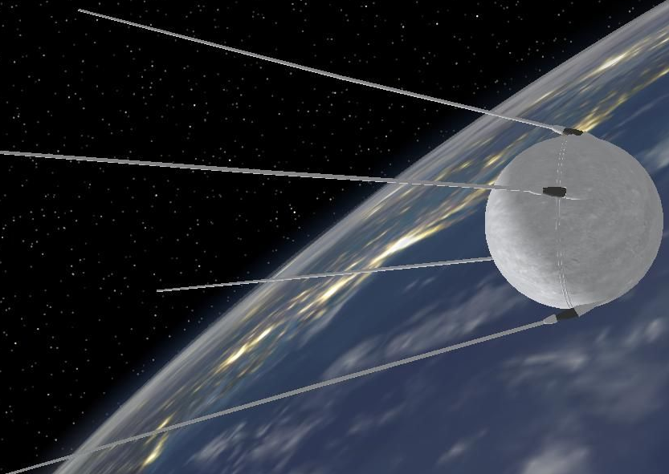
Notes:
`dogs

Slide 8
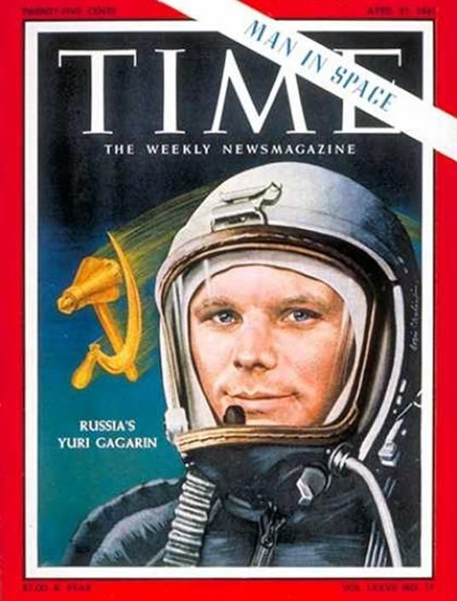
Notes:
McMllan

Slide 9
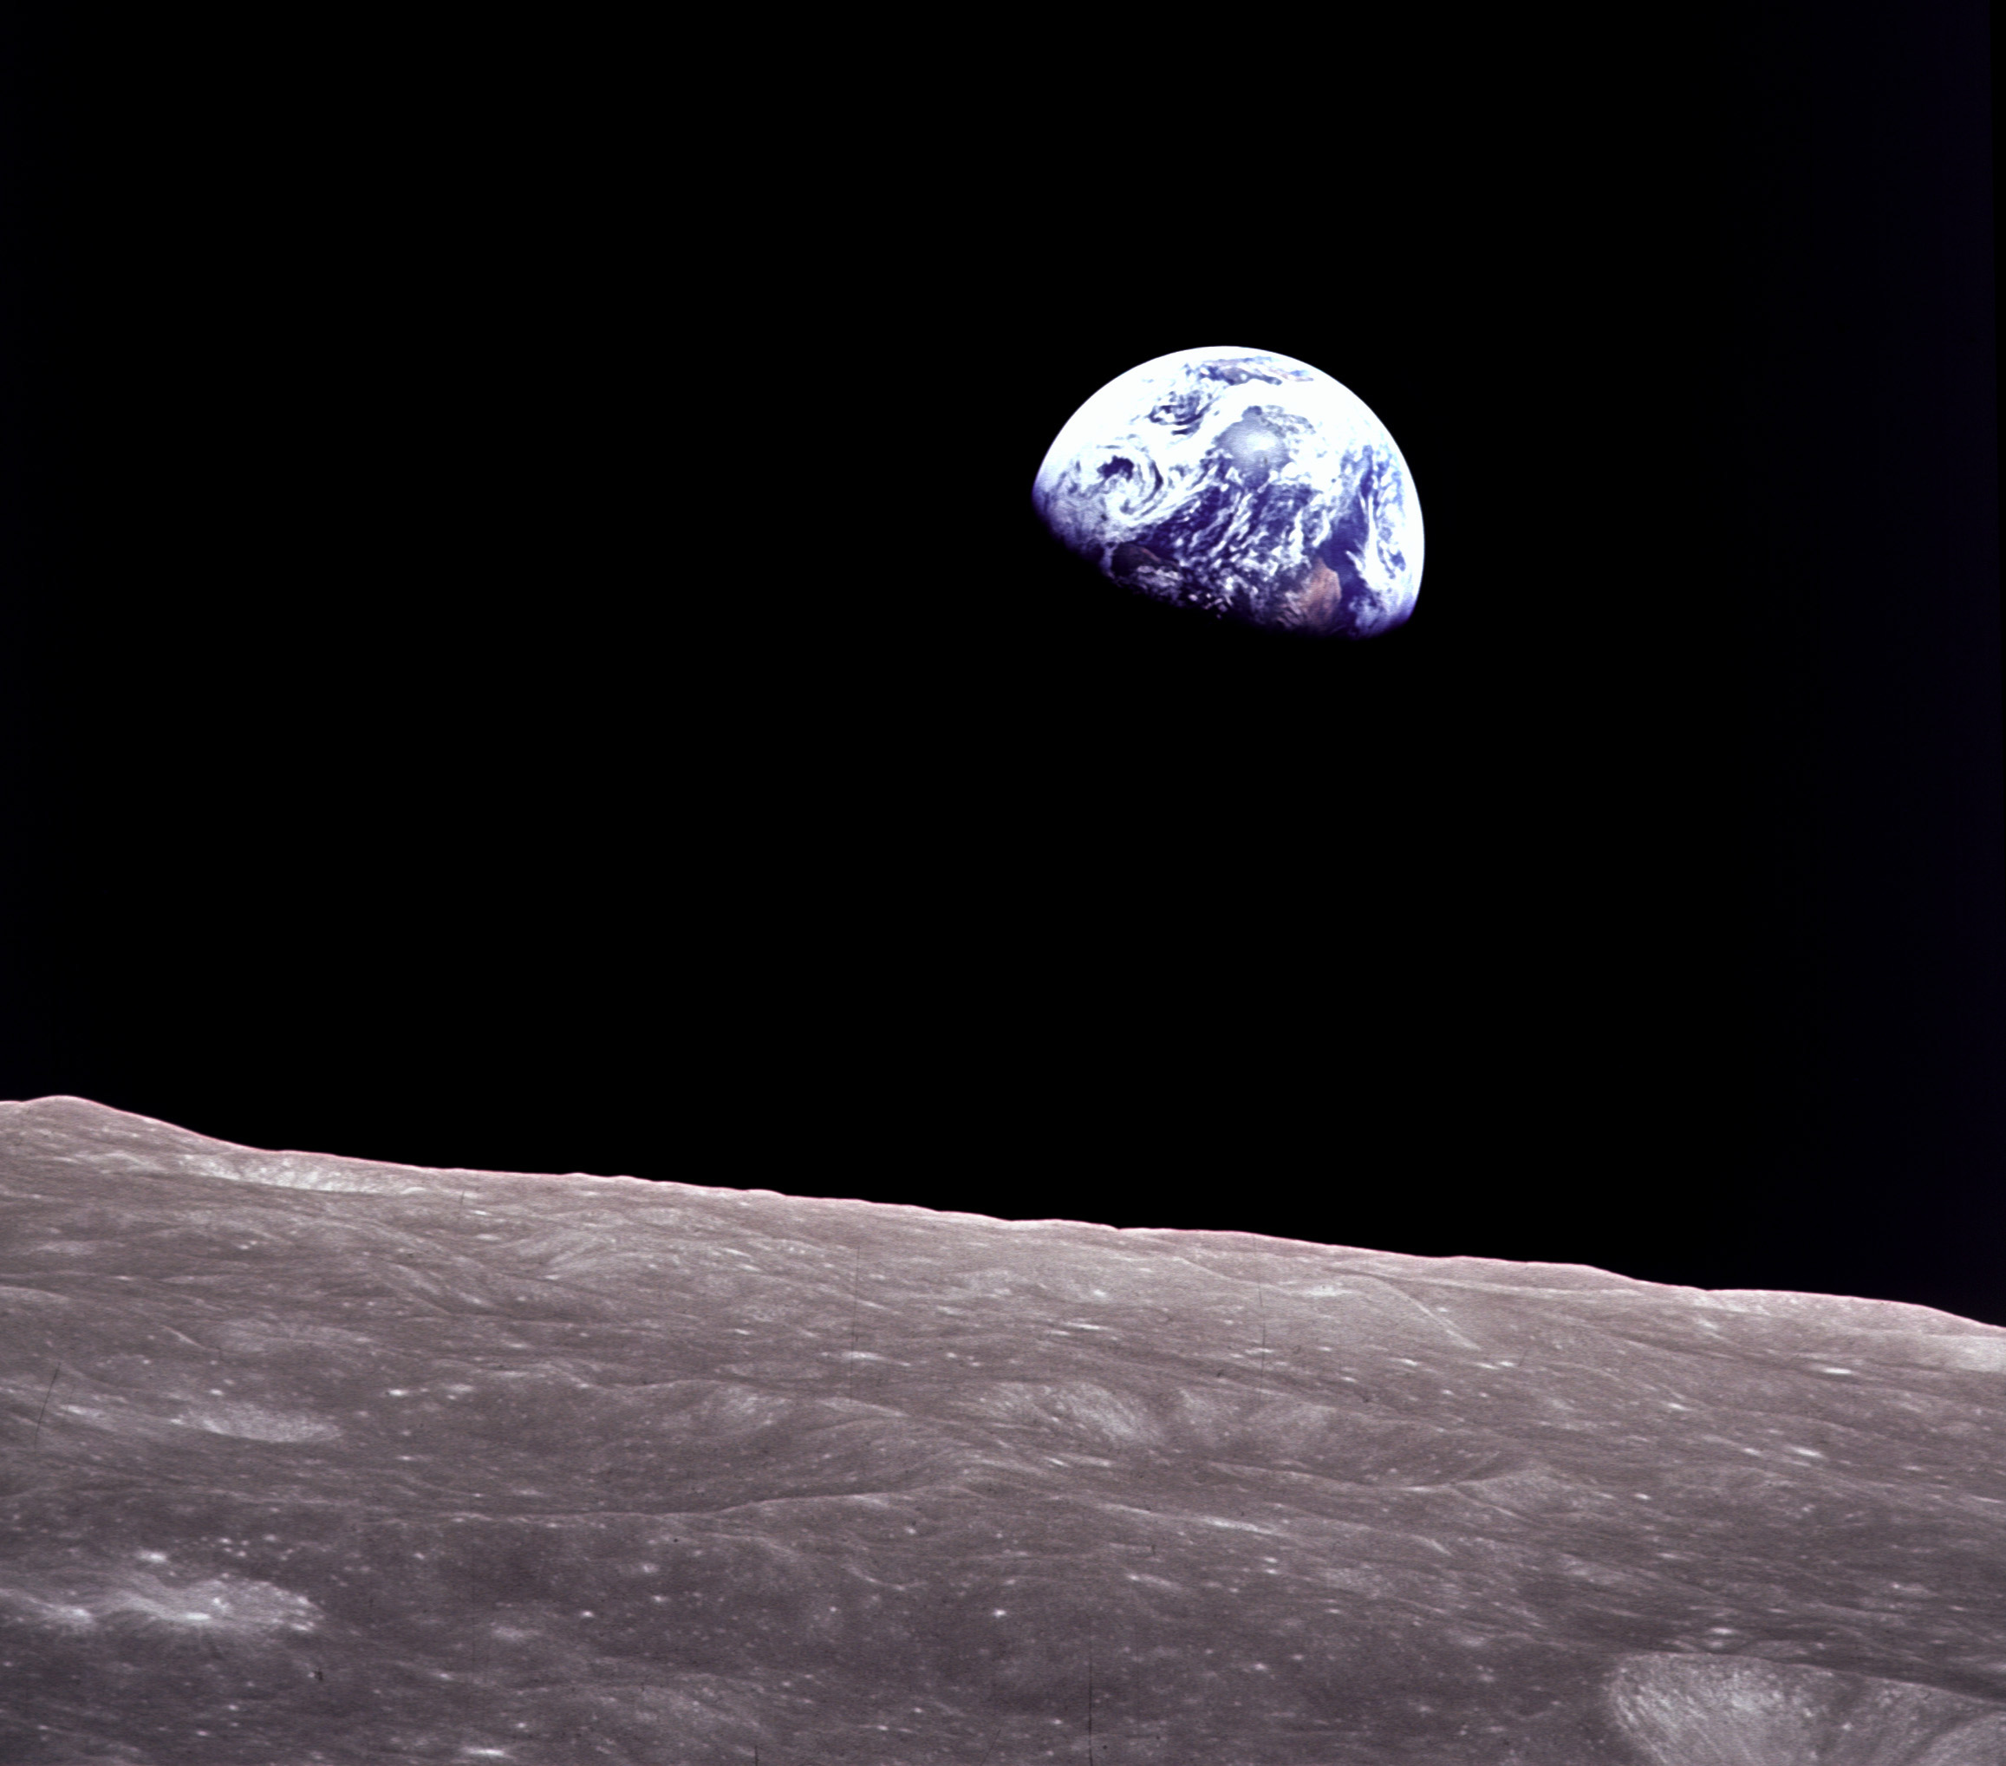

Slide 10
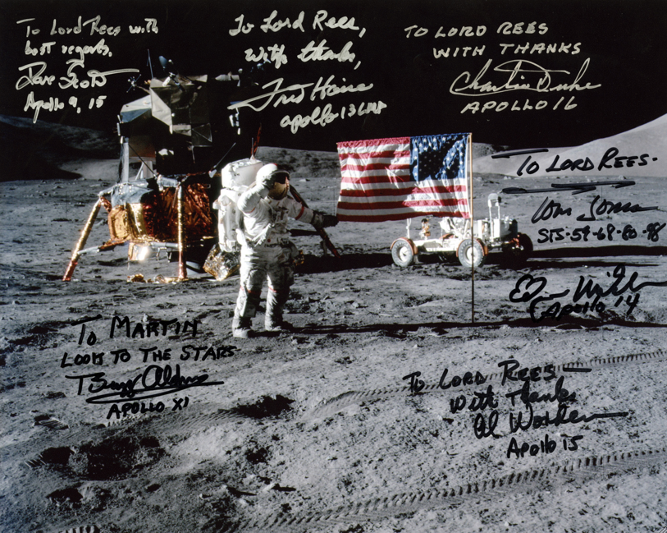

Slide 11
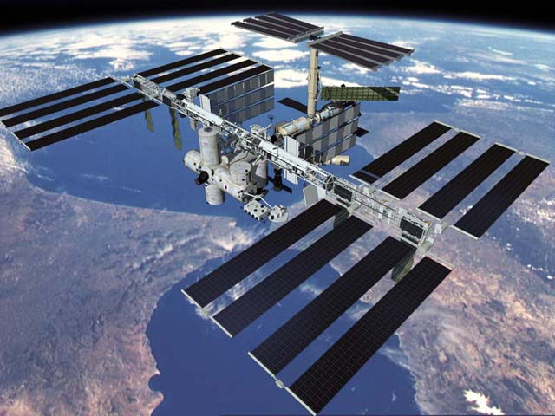

Slide 12
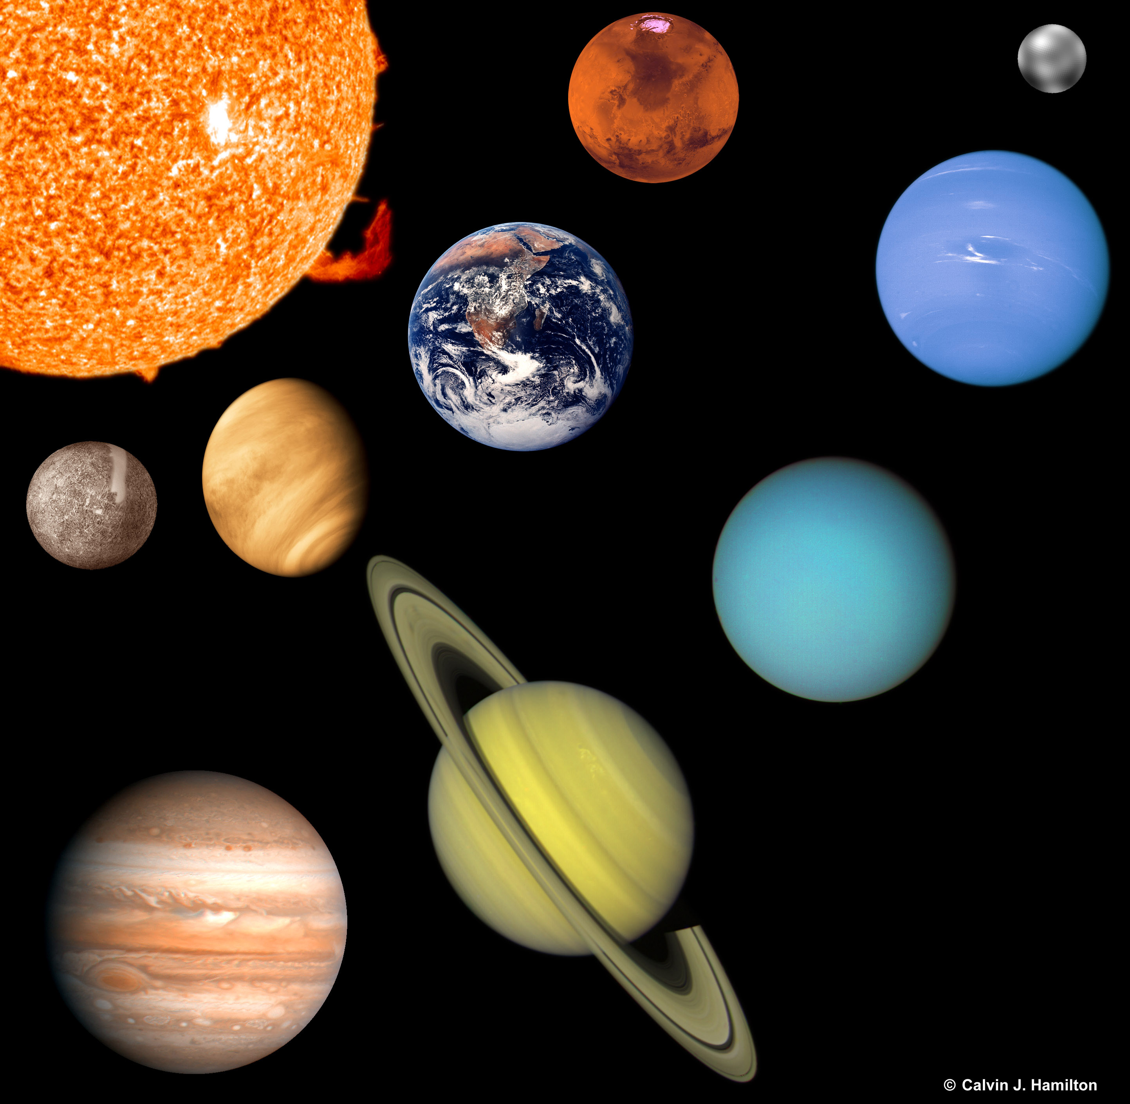

Slide 13
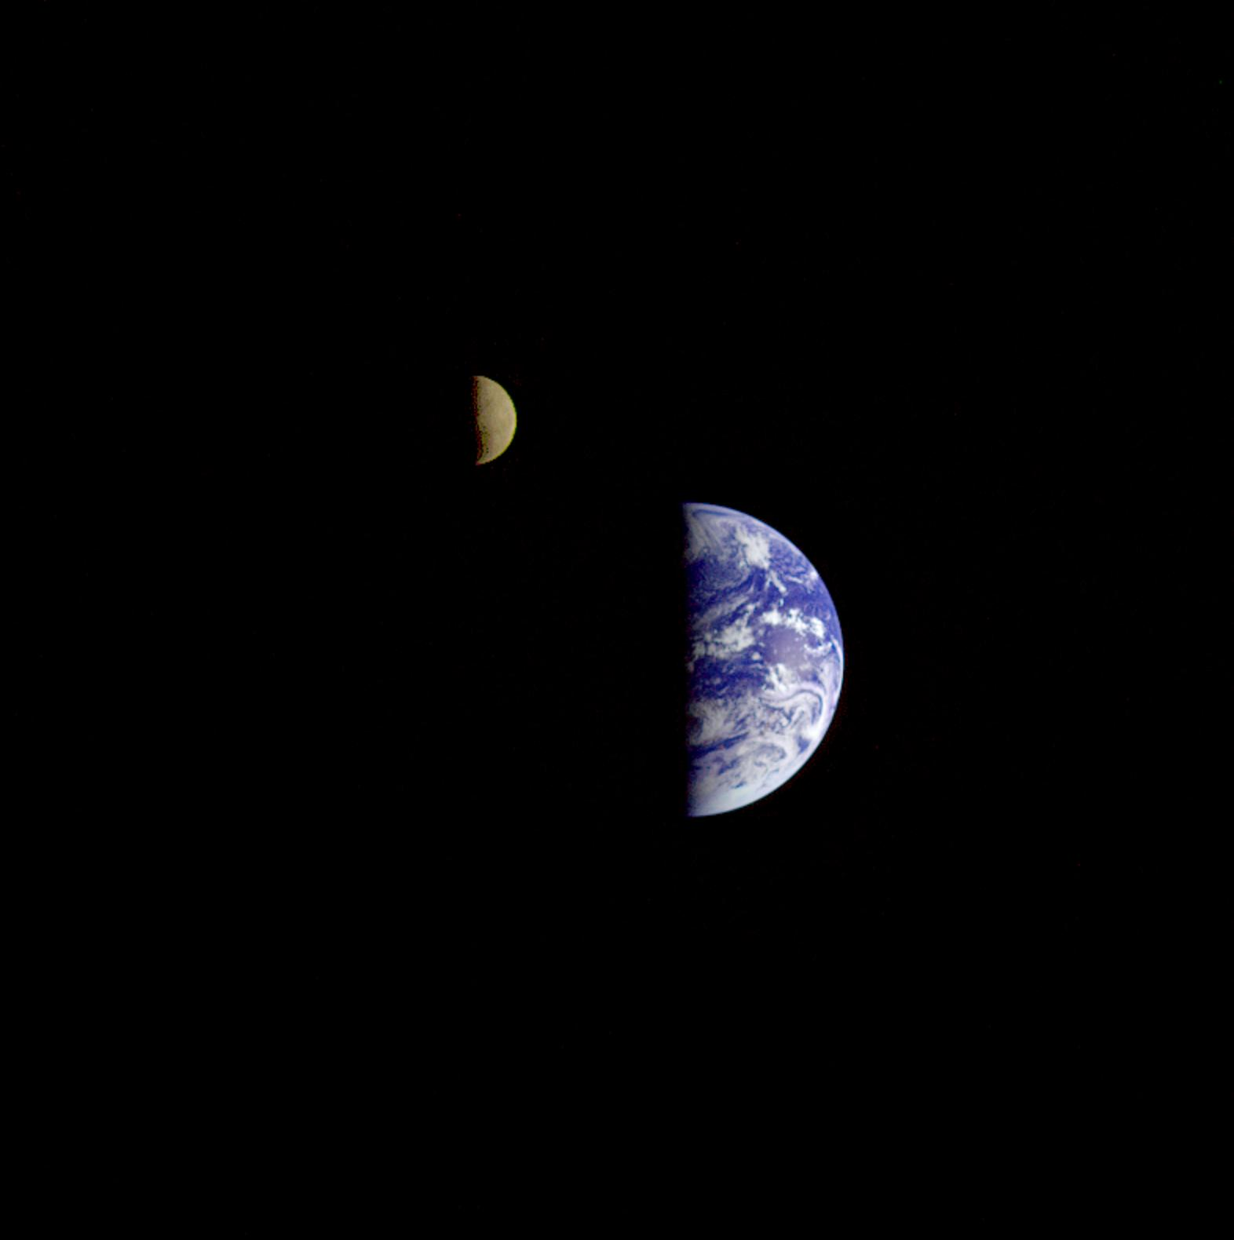
Notes:
View of earth and Moon from galileo space craft on 16 dec 1992 on its way to Jupiter. Moon is closest to us. Distance is 6.2 million km, about 16 times the Earth Moon distance of 384 400 km. View is from below.
Jupiter is 1047 Earth mass but same mass satellites.
Earth 81 times Moon mass
Jupiter 12000 to 40000 satellite masses

Slide 14
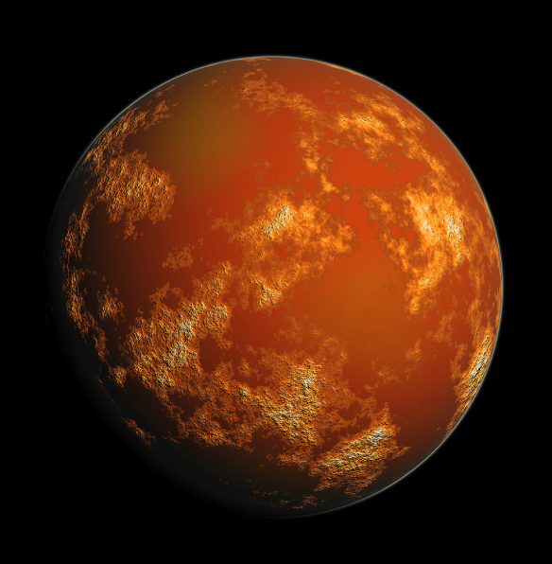

Slide 15
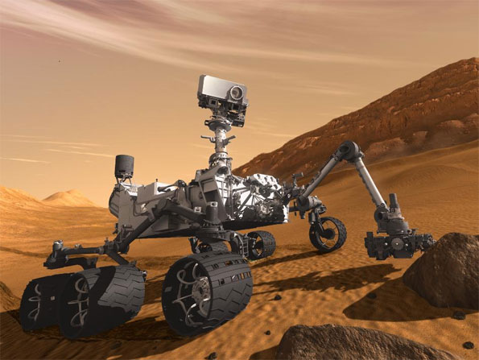

Slide 16
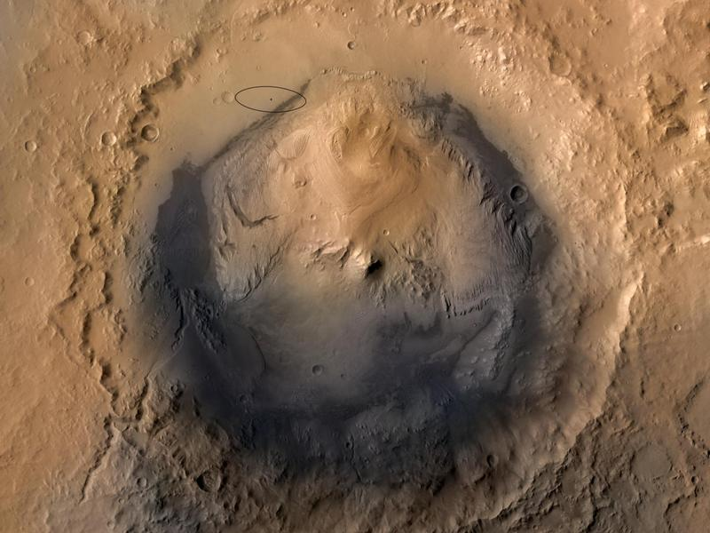

Slide 17
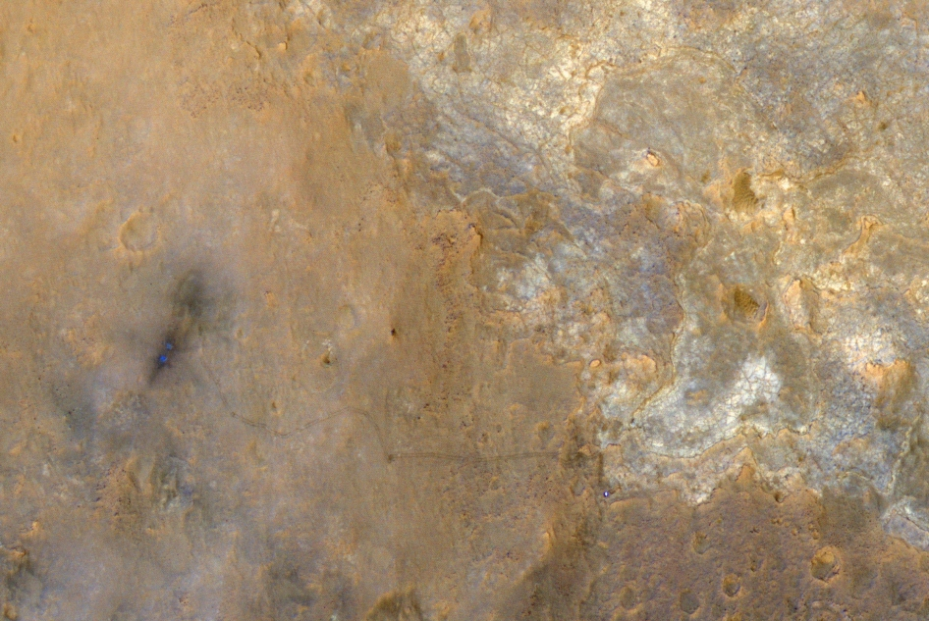

Slide 18
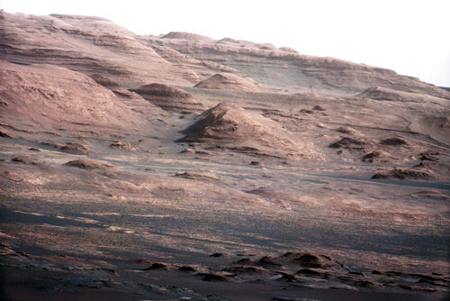

Slide 19
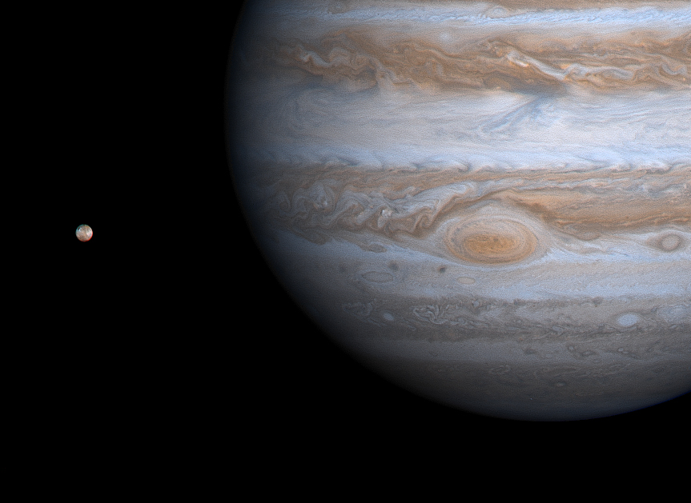

Slide 20
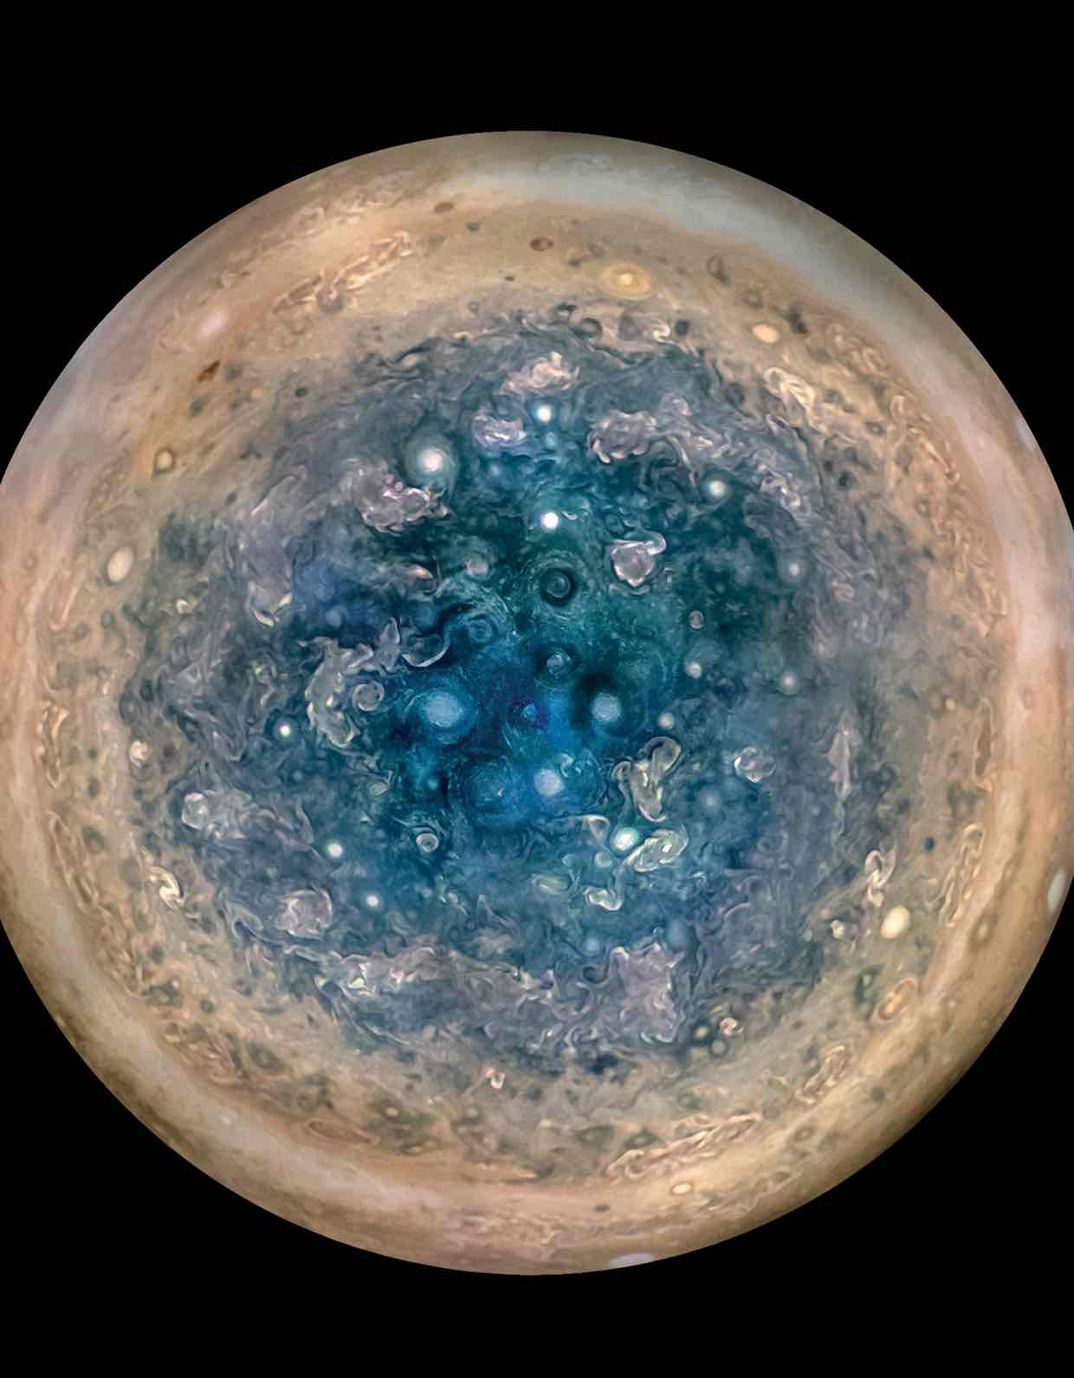

Slide 21
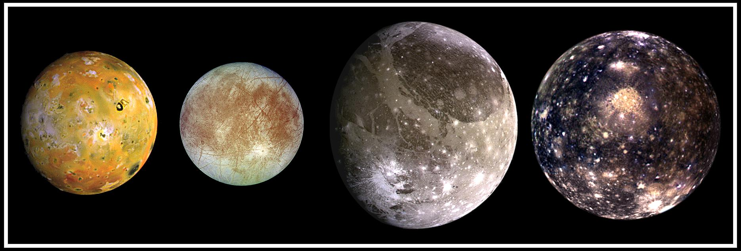
The Satellites of Jupiter
Io
Europa
Ganymede
Callisto

Slide 22
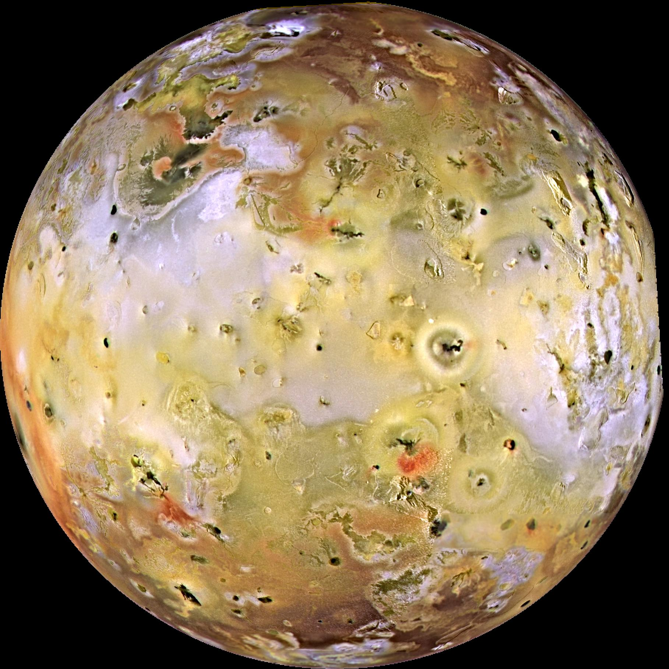

Slide 23
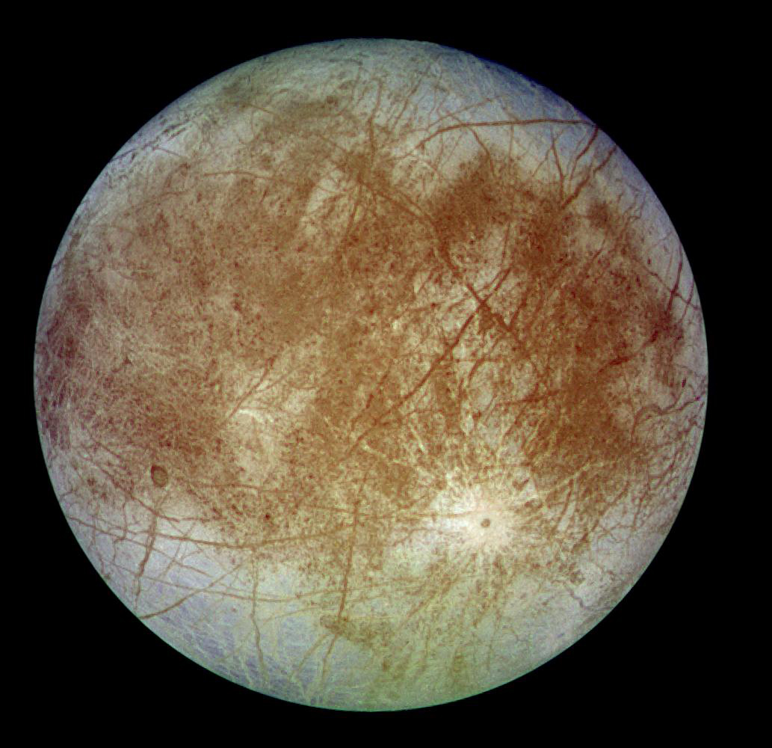

Slide 24
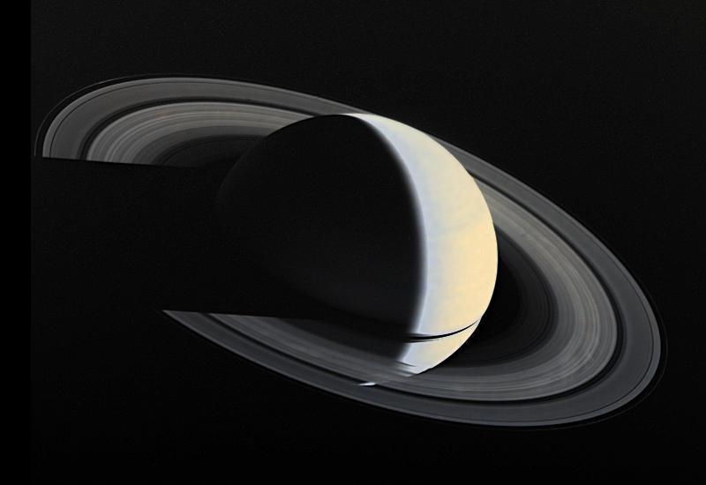
Notes:
Voyager image Saturn flyby showing shadow cast on rings and transparent rings.

Slide 25
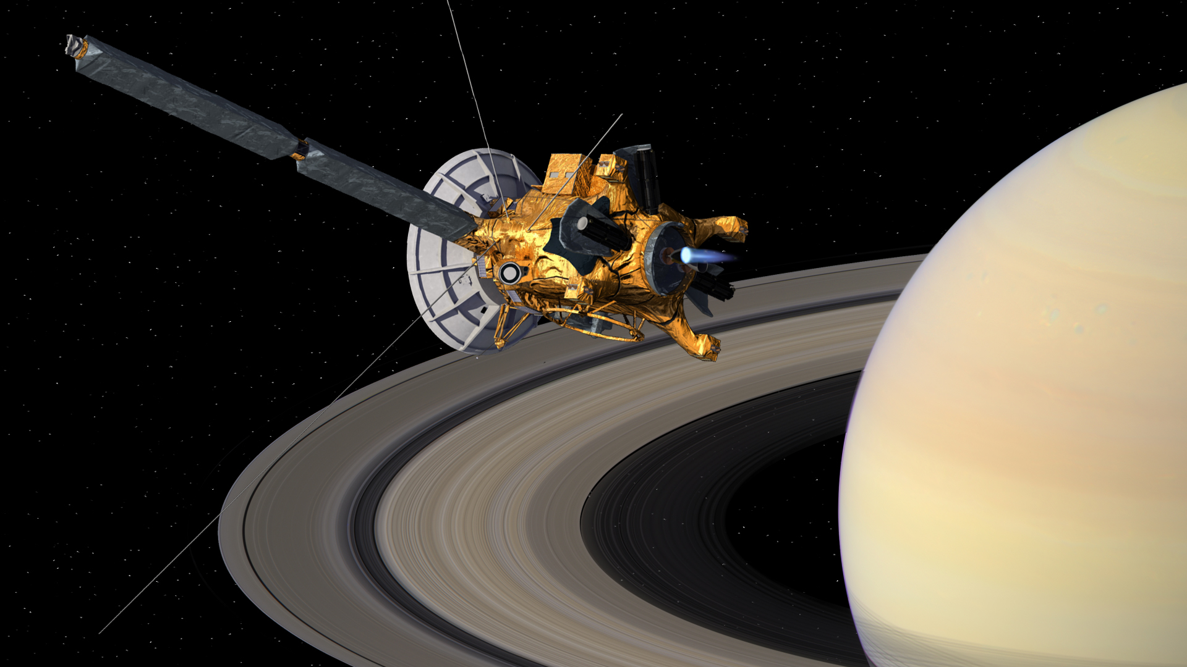

Slide 26
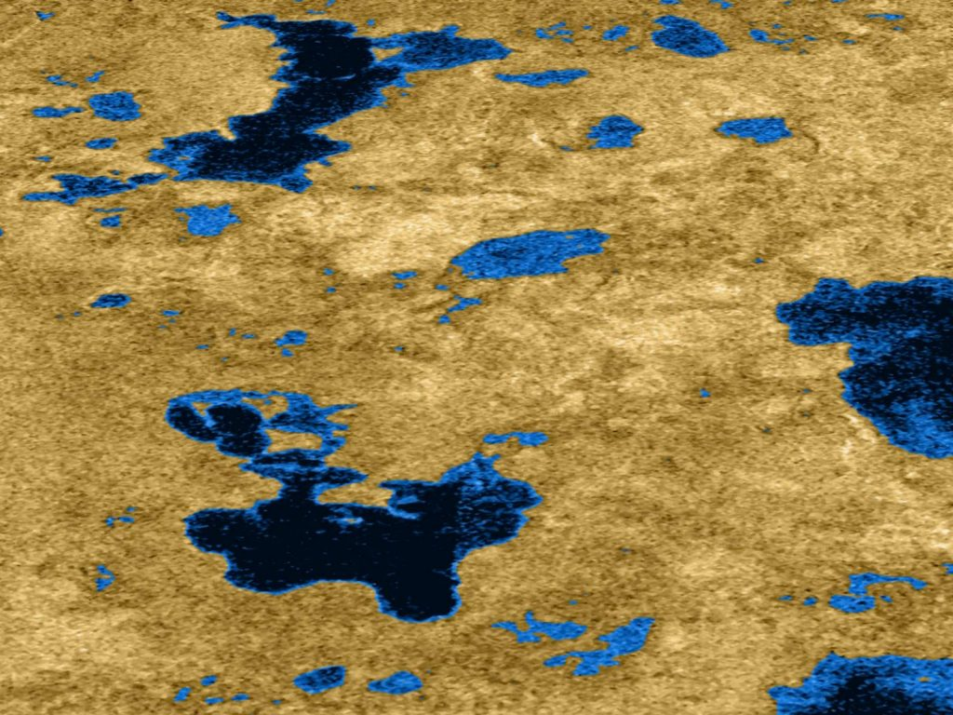

Slide 27
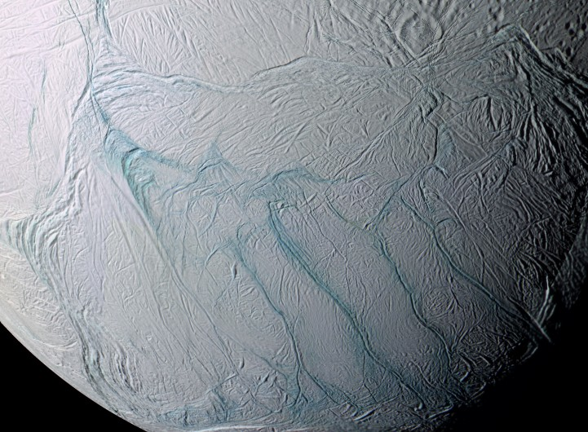
Notes:
Magan donahue’s group – CASSINI
30km of surface

Slide 28
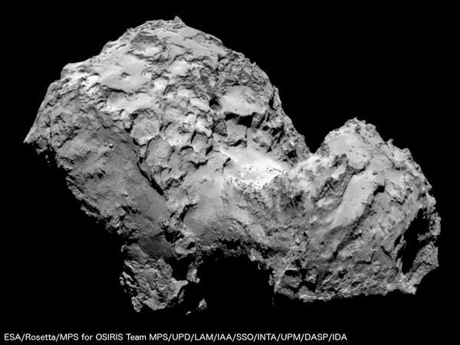

Slide 29
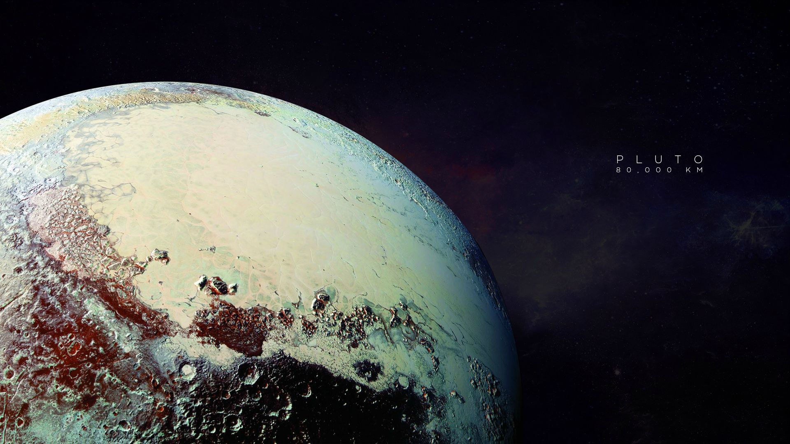

Slide 30
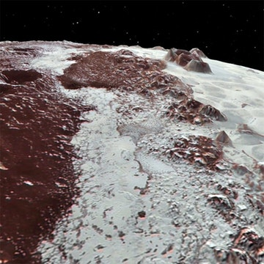

Slide 31
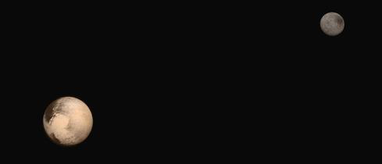

Slide 32


Slide 33


Slide 34
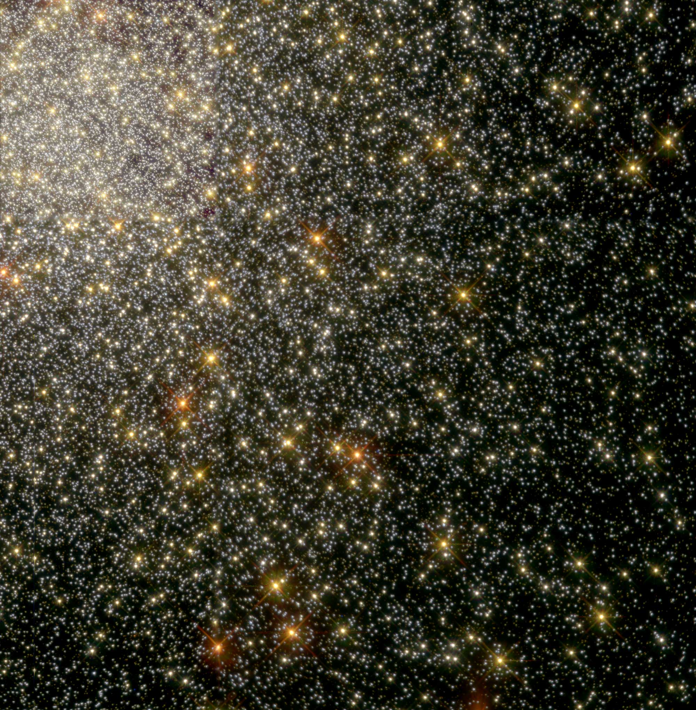

Slide 35
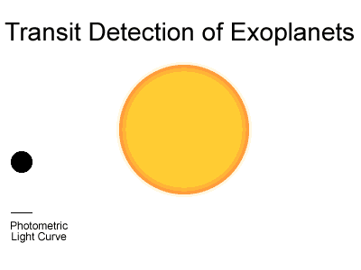
Notes:
Transit simulation. If all 100 000 stars have an earths ized planet at the earths distance from the star, then because of random orientation only about 20 will be discovered. If none are discovered then this means that less than 55 have earth like planets.

Slide 36
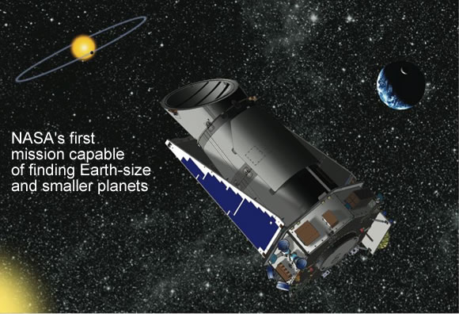
NASA Kepler Mission
Launch March 09
Notes:
Launch 2008 into trailing Earth orbit ( 0.5 AU after 4 years). Will observe transit 1/10,000, must be periodic and same amp, lasting same time. To detect Earth size planets in the habitable zone. Will observe a small area of sky in direction along Orion arm (L=45) in Cygnus lyra.
ESA may have a similar mission called Eddington, post 2008

Slide 37
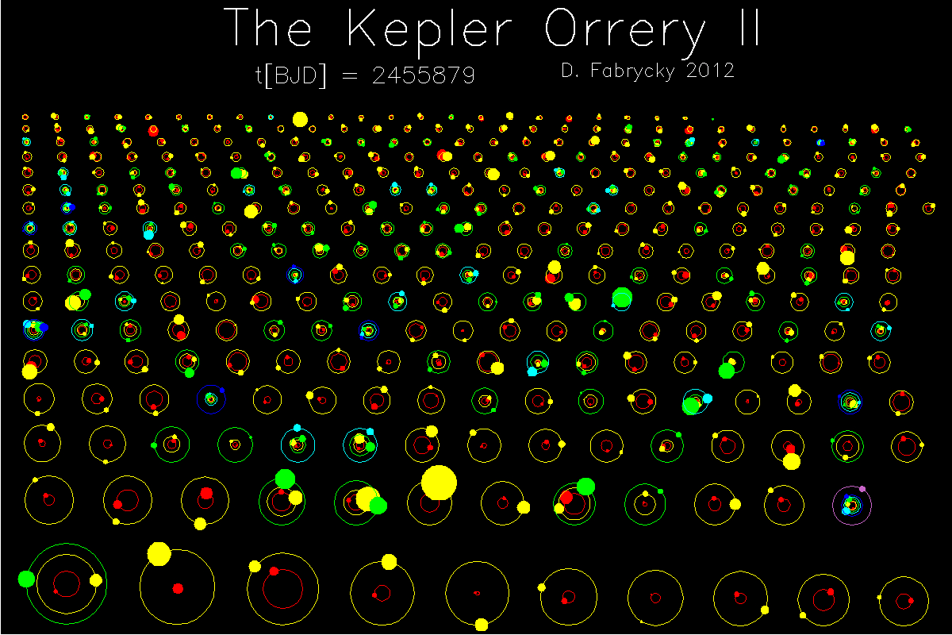
From Mars to the Multiverse
Martin Rees
Amer Phys Soc, Jan 2017
Notes:
Honour
Pleasure to share with other two

Slide 38
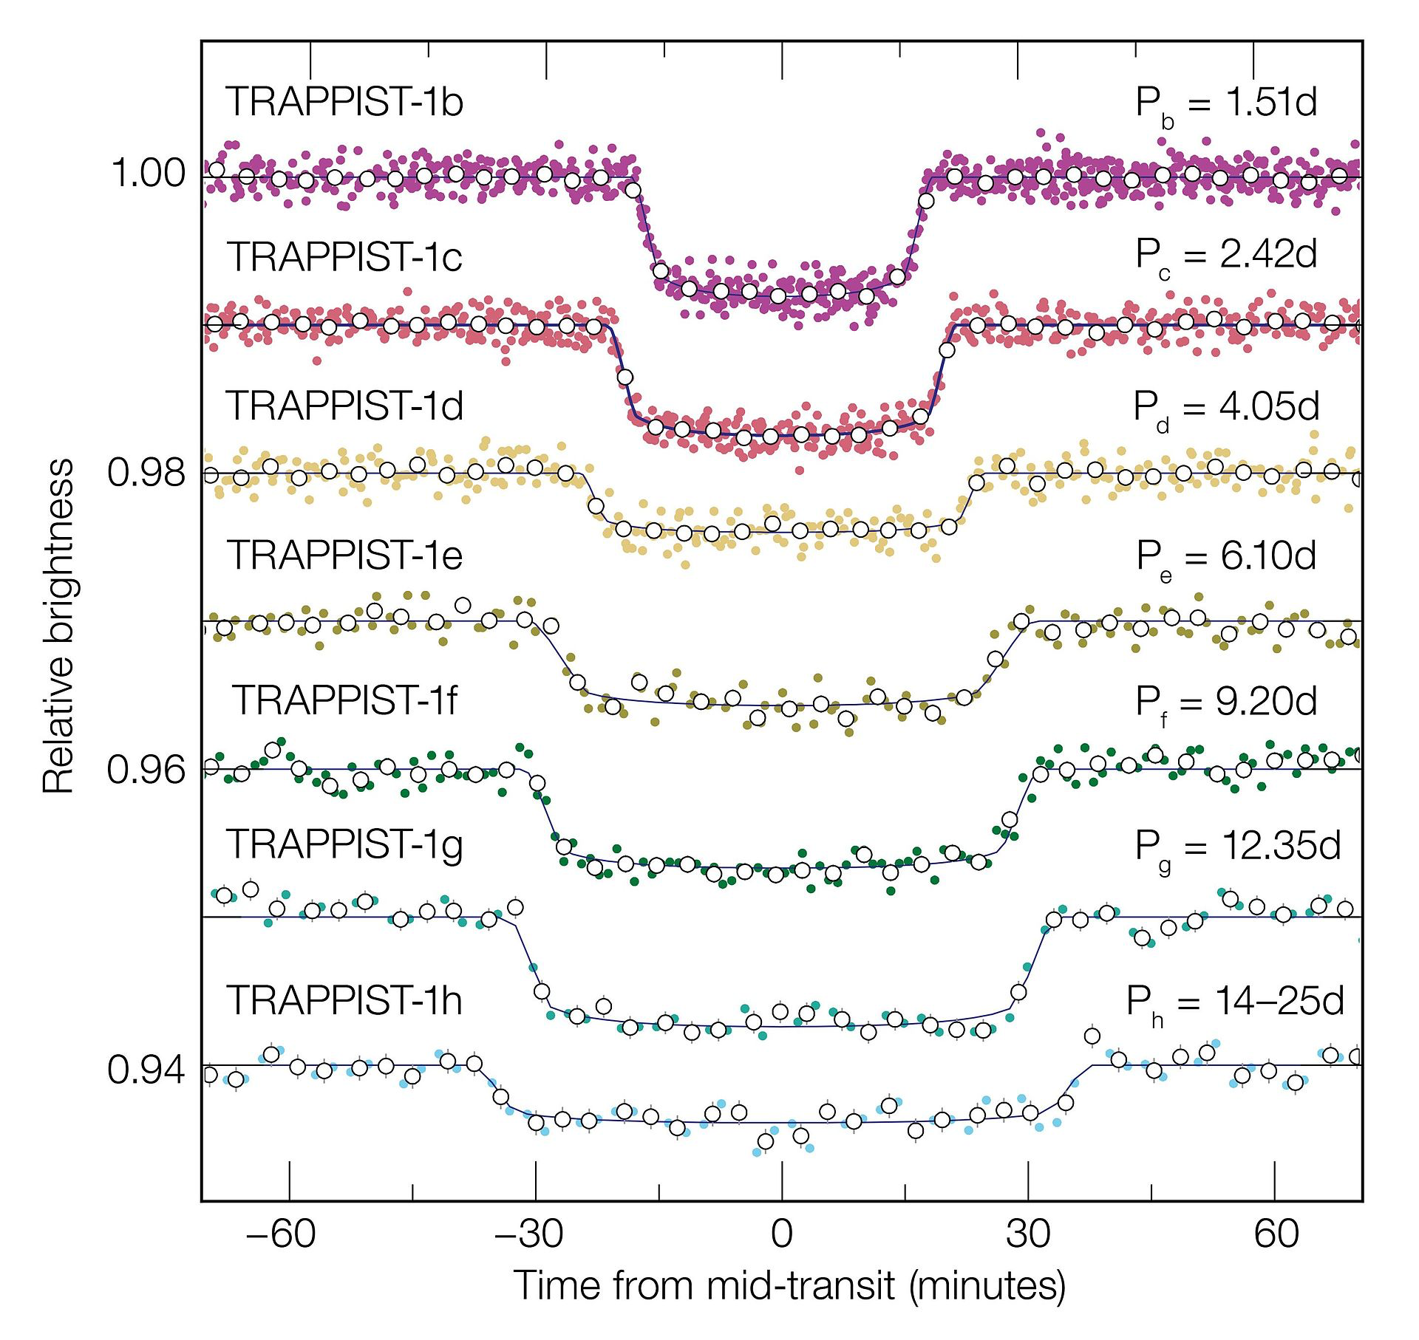

Slide 39
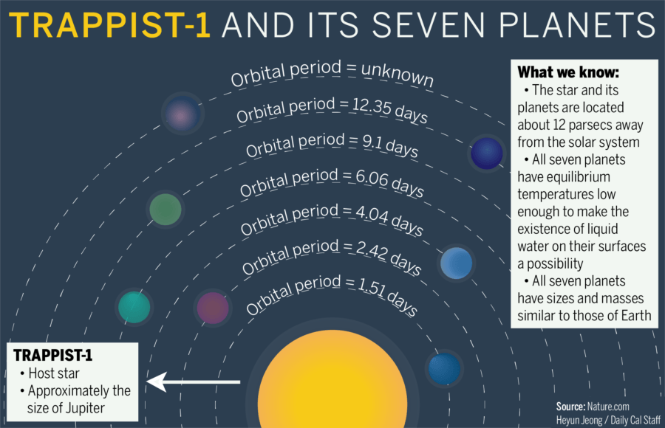

Slide 40


Slide 41
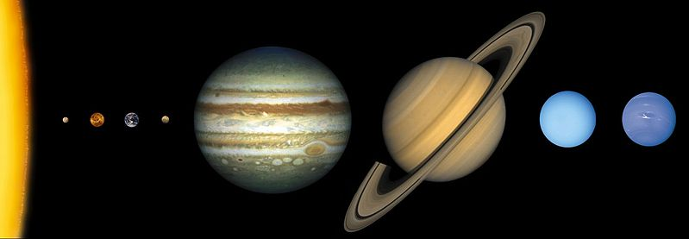
The Quest for Life in the Universe
Almost every star has a planet around it
One in every six stars has an Earth-size planet

Slide 42
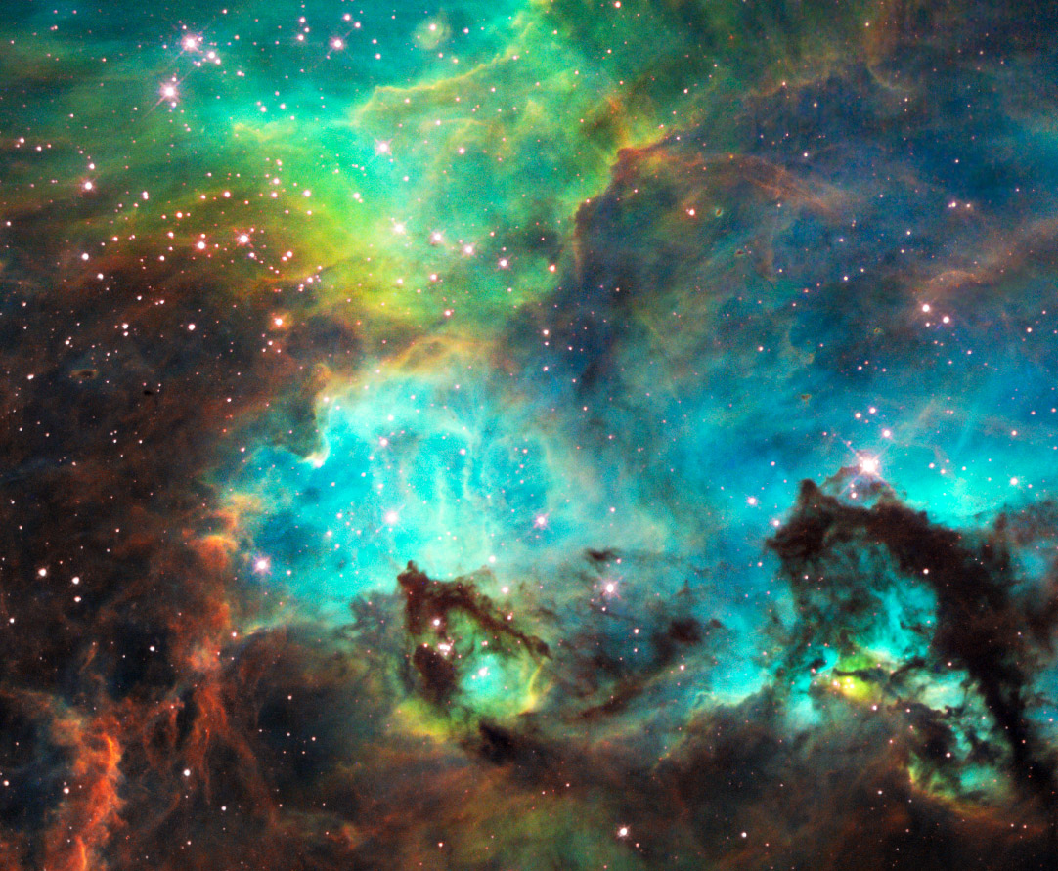

Slide 43
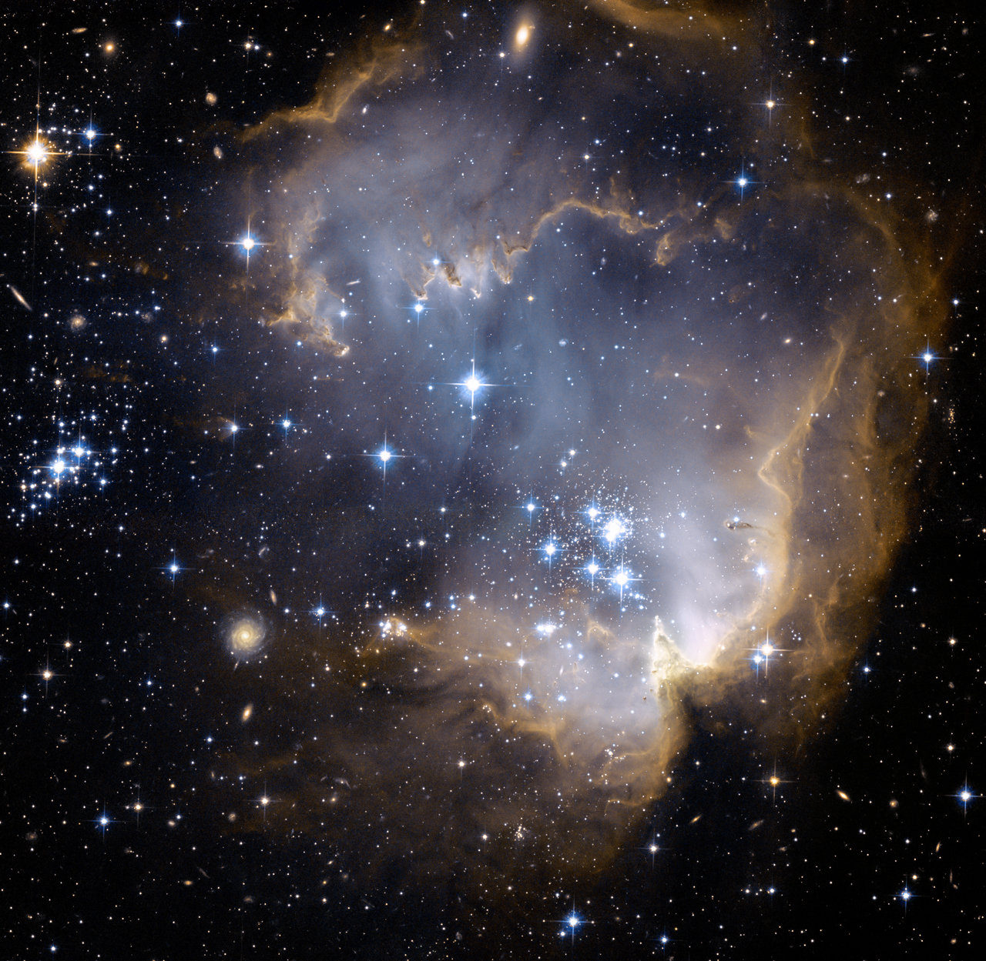
Notes:
Intelligent life?
Private sources – Russian investor 100m dollars Chair this effort

Slide 44
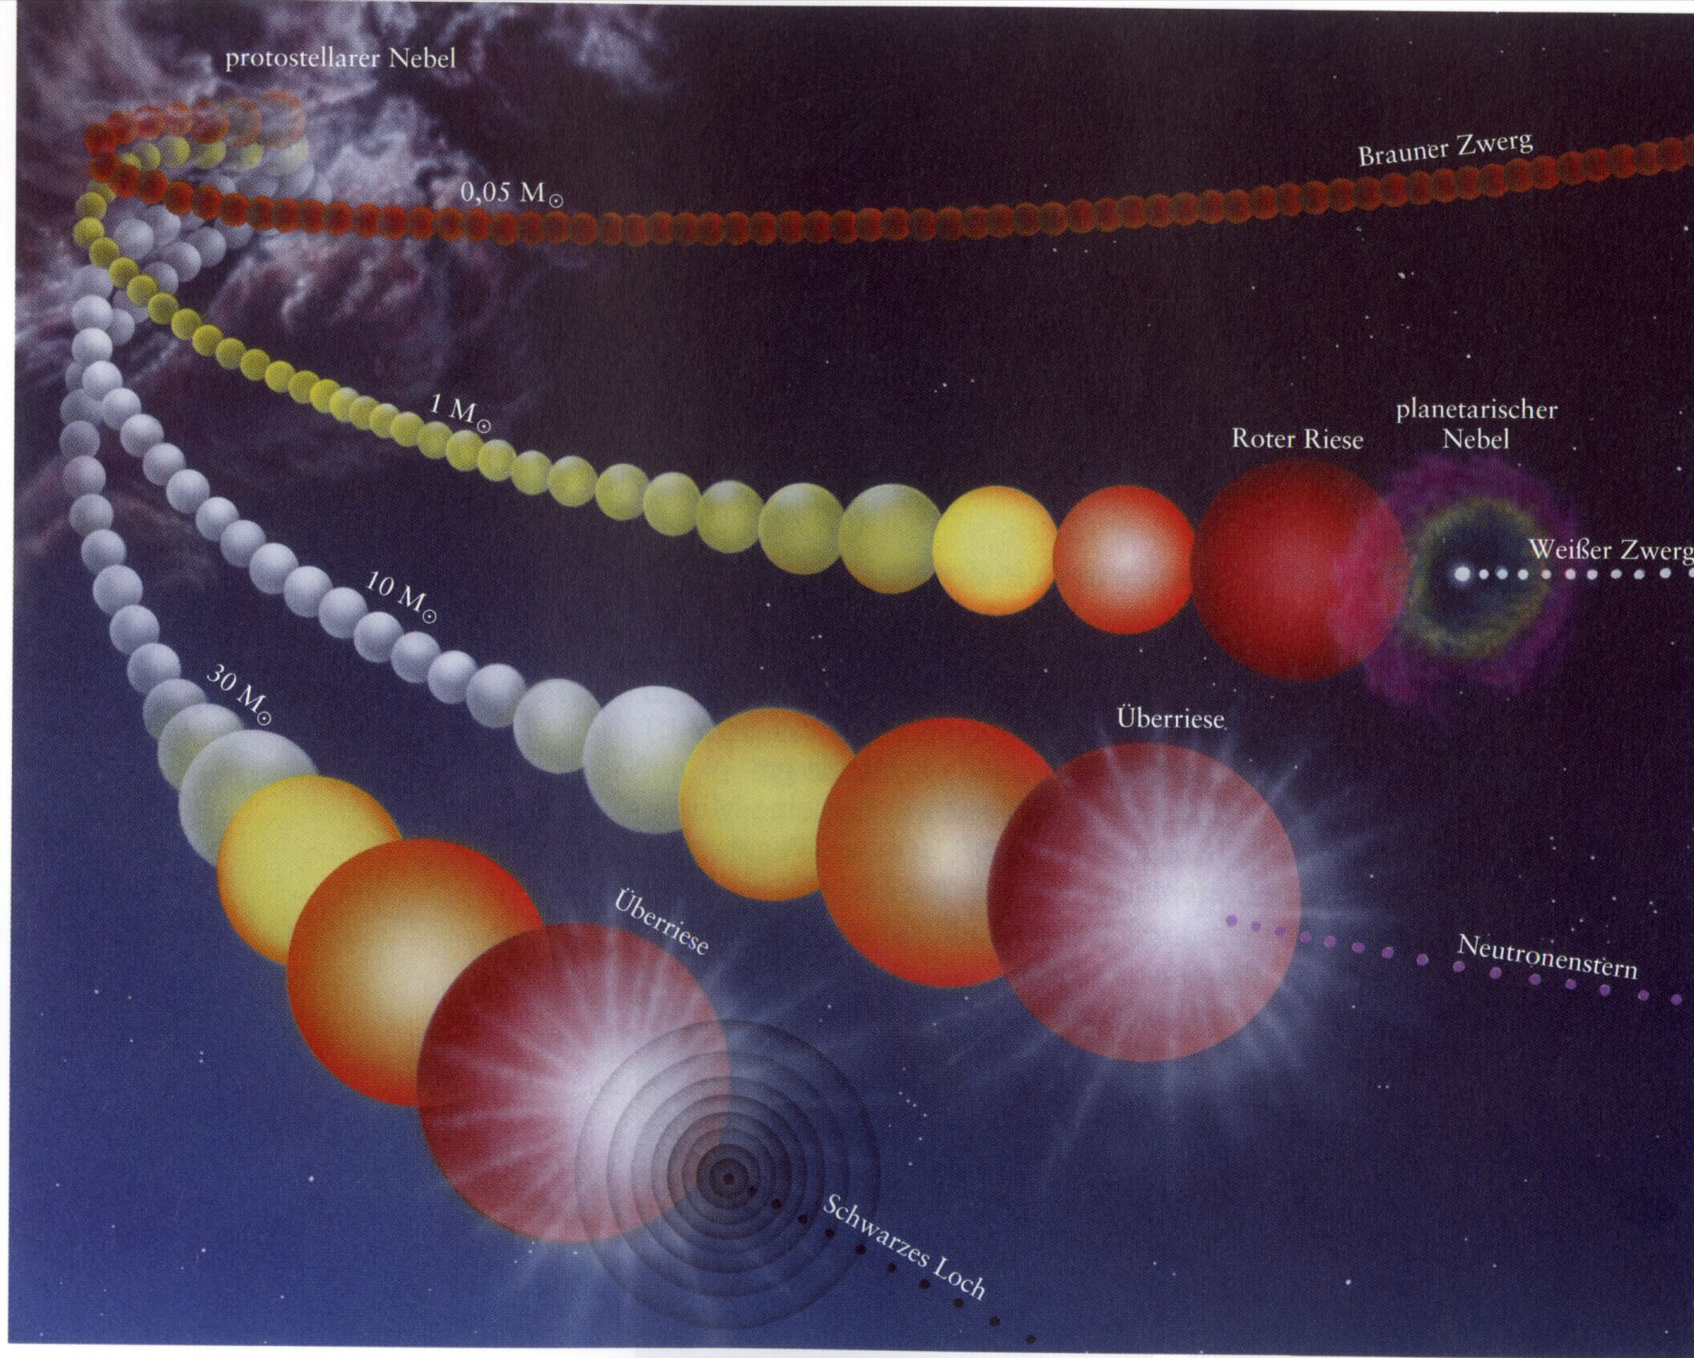
Life and Death of Stars
White Dwarf
Neutron Star
Black Hole

Slide 45
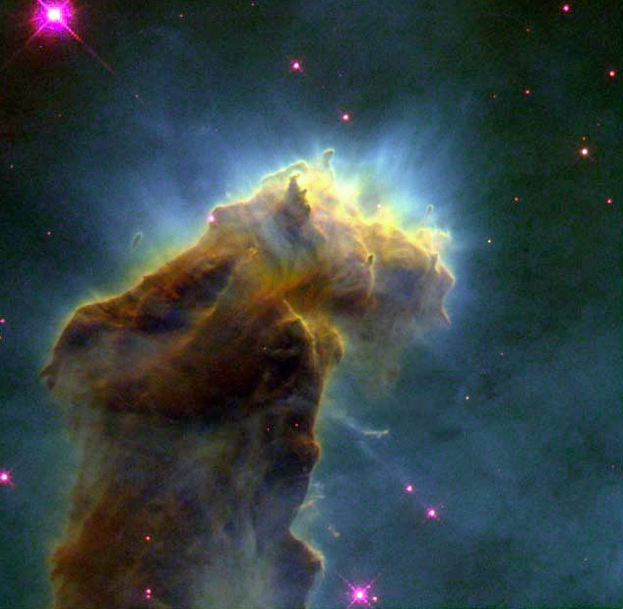

Slide 46
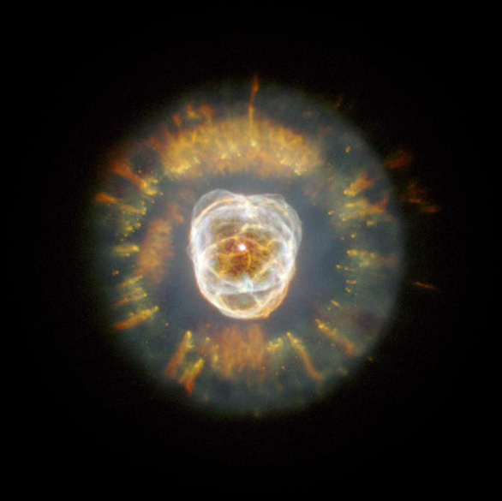

Slide 47
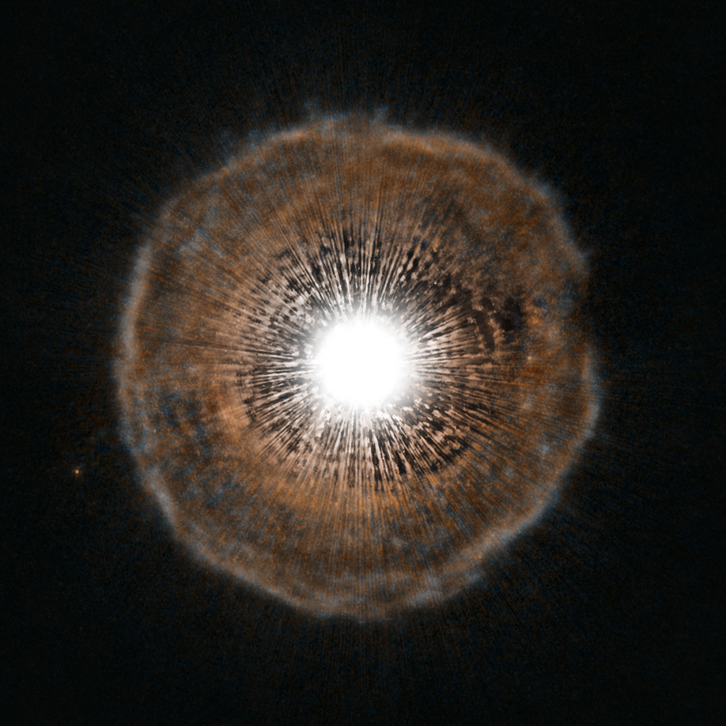

Slide 48
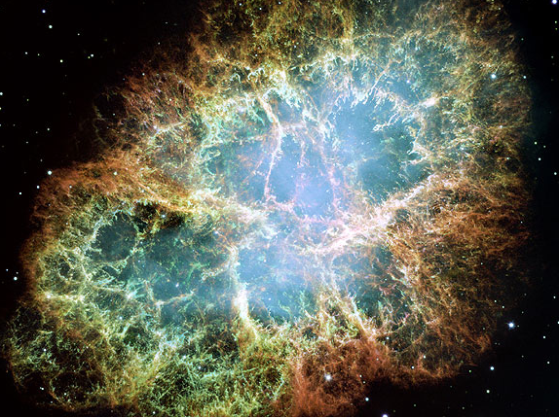

Slide 49
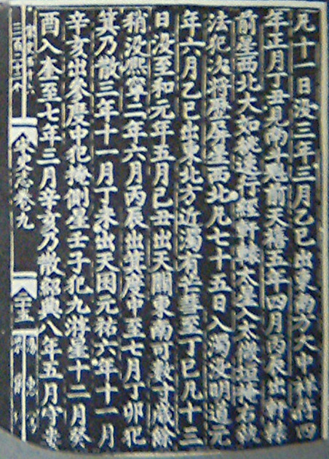

Slide 50
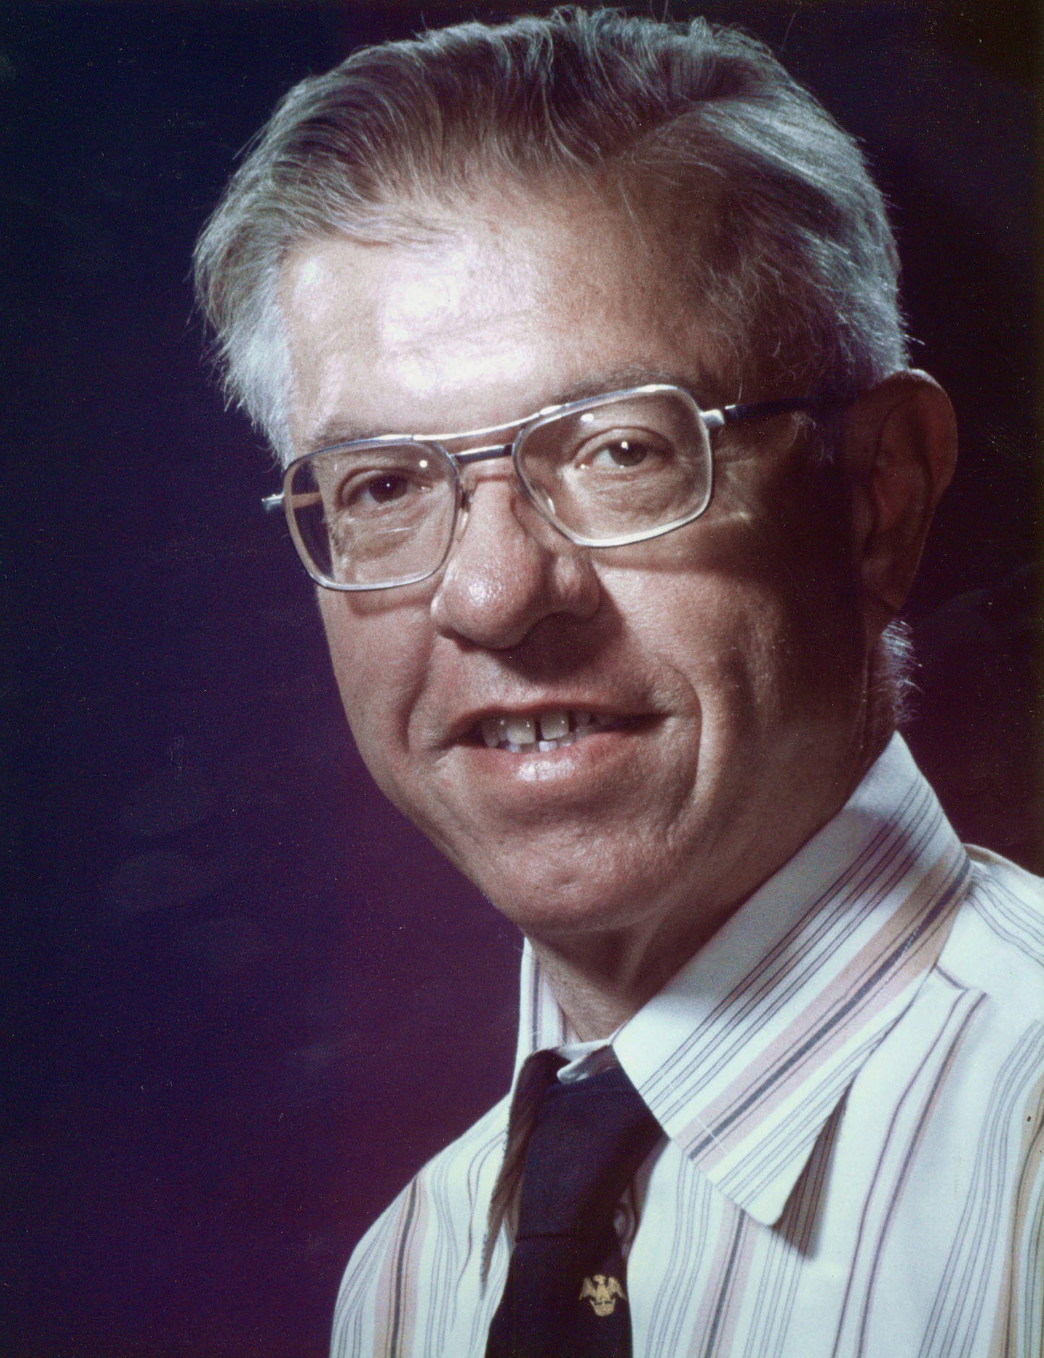

Slide 52
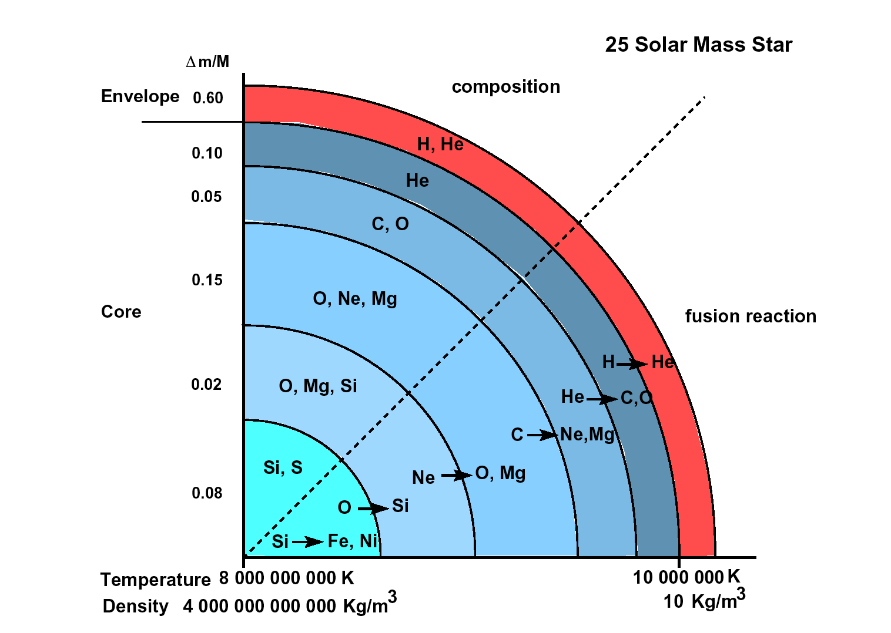

Slide 53
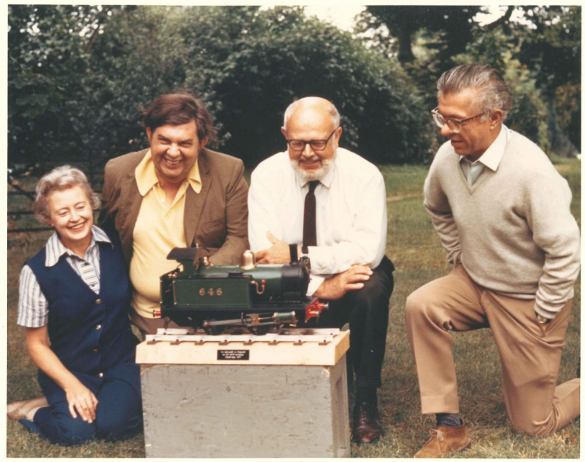

Slide 54
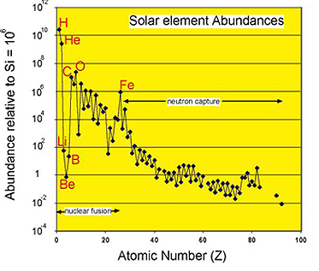

Slide 55
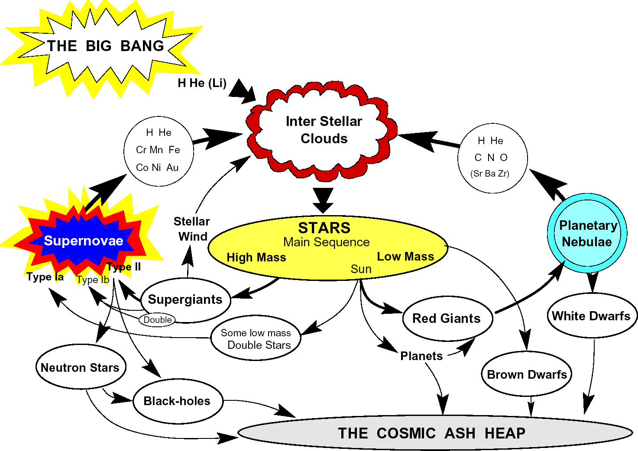

Slide 56
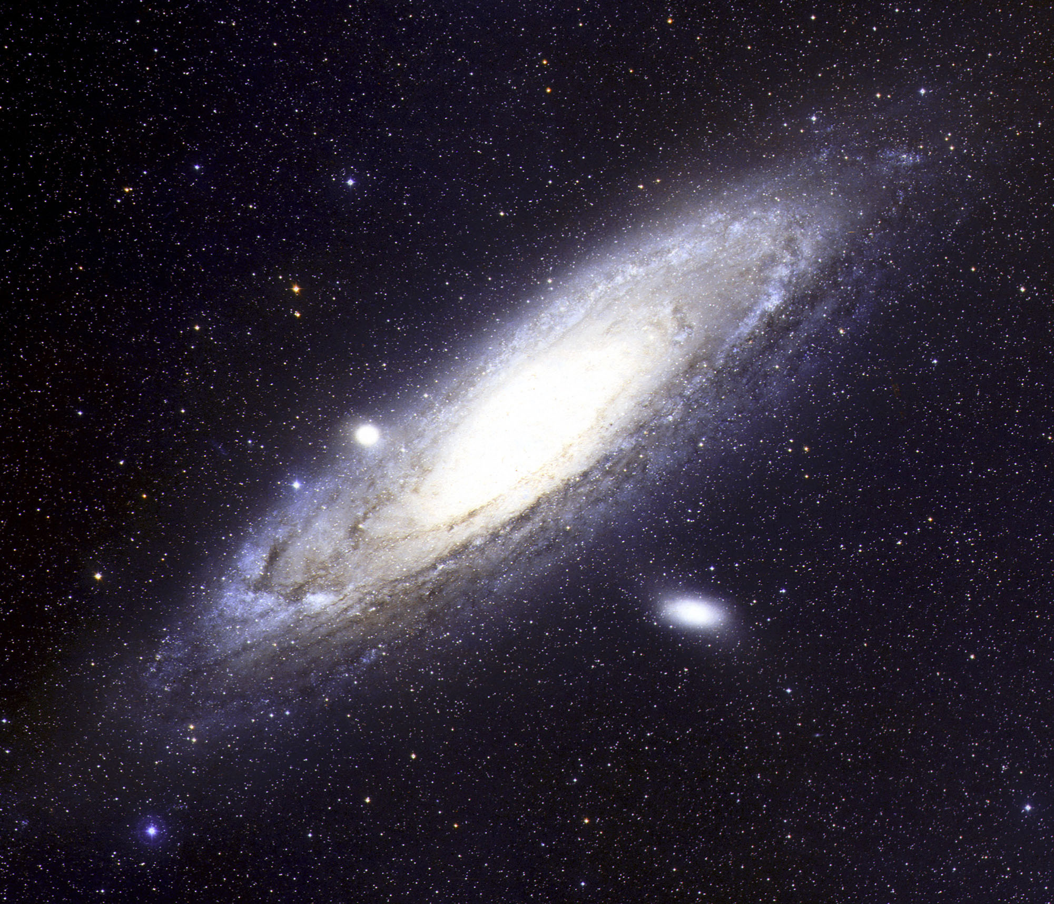

Slide 57
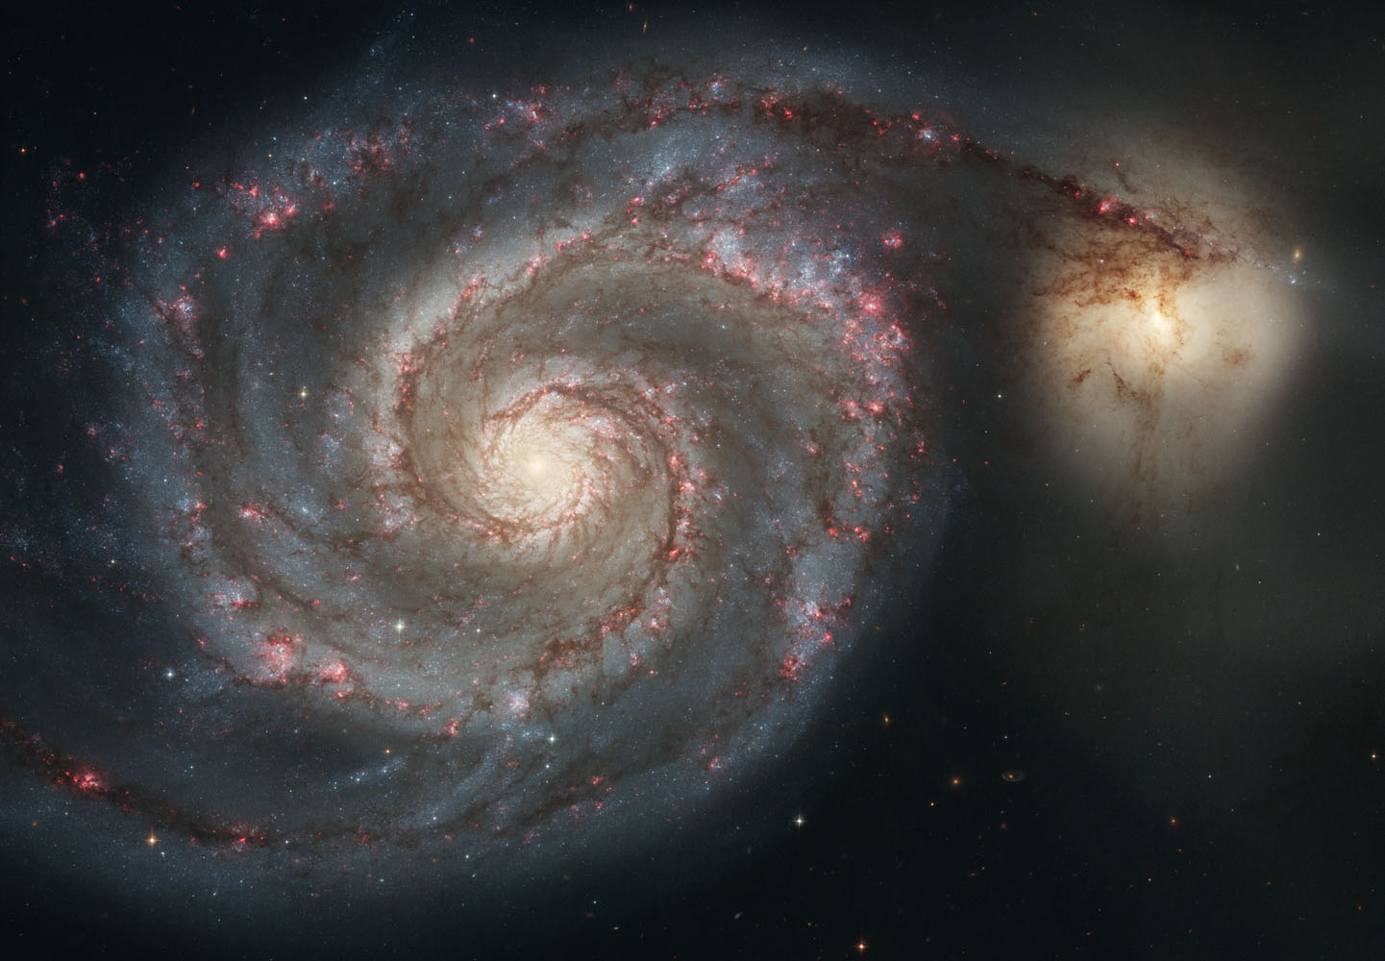

Slide 58

600 Mly
Coma
Centaurus
Pisces-Perseus

Slide 59

Notes:
Gallaxy collision movie from the Hawaii Research web site. The red indicates the dark matter making up 80% of the mass.
It simulates the formation of the antennae galaxy collision.
Looks like Antennae half way through
Spanning about 1000 million years

Slide 60

Notes:
NGC4676 from HST. Galaxies undergoing collision about 160M years after closest approach.
Distnace 420Mly

Slide 61


Slide 62



Slide 63

FORS2@VLT(< 1μ) plus GNIRS@Gemini North (>1μ)
Mortlock et al. 2011
The red curve is not a fit but a template from 169 SDSS QSO spectra at
2.3<z<2.6 with large CIV blue shifts.

Slide 64


Slide 65


Slide 66


Slide 67

Cosmic Evolution -Cartoon
Recombination
Nucleosynthesis
Well-understood
nonlinear simulations
Notes:
Standard timechart
Three eras

Slide 68


Slide 69


Slide 70

PPP

Slide 71

Tegmark
We know the DM power spectrum very well!

Slide 72
What happens in the far future?
Notes:
So much for the past – what is the long range forecast?

Slide 73

Notes:
50 years ago we had these three scenarios. No clear evidence (ideological preference for closed0

Slide 74
Cosmic Evolution -Cartoon
Recombination
Nucleosynthesis
Well-understood
nonlinear simulations
Notes:
Standard timechart
Three eras

Slide 75
What caused the fluctuations?
Why does the universe expand the way it does?
Why does it contain the observed ‘mix’ of atoms, radiaetion and dark matter?

Slide 76

Notes:
Often said that things that in principle are unobservable aren’t part of science.
Aversion therapy.
Limit of telescope.
Beyond horizon
-- acceleration
Everyone believes in galaxies that can never, ever be observed.
Afternmath of other big bangs

Slide 77


The Very Early Universe
Real size!
Notes:
77

Slide 78
Cosmic Evolution -Cartoon
Recombination
Nucleosynthesis
Well-understood
nonlinear simulations
Notes:
Standard timechart
Three eras

Slide 79
HOW MUCH LIES BEYOND OUR HORIZON (10¹⁰ 1.y distant)?
Cannot be sure of anything beyond present causal horizon.
Moreover, topology could be complex or 'kaleidoscopic'.
But lack of discernible gradients (in CMB or galaxy counts) across Hubble scale suggest that our universe extends for > 10¹⁵ l.y
and space could extend > 10¹⁰⁰ l.y
or even >>>>>>
(replicas!)
Moreover, this immensity could be the aftermath of just
one big bang out of many (eternal inflation, braneworlds, etc)

Slide 80

Notes:
Cartoon of ‘eternal inflation’

Slide 81

Notes:
Key questions for 21st century

Slide 82
Prerequisites for complex cosmos
Gravity – to enhance density contrasts in the expanding universe, and to bind stars and galaxies together.

Slide 83

Notes:
Remember Dirac

Slide 84


Slide 85
NOTE:
G must be weak, but is not ‘fine-tuned’ – the universe might be even more interesting if it were still weaker.
Notes:
No fine tuning – contrary to what books say.

Slide 86
Prerequisites for complex cosmos
Gravity -- but weaker the better (at least one very large number in physics)
Non-trivial chemistry (‘tuning’ between nuclear and e-m forces)

Slide 87



Semi-empirical mass formula (von Weizsäcker 1935, …):
How do these numbers depend on (α,Λ_{QCD},m_{u},m_{d})?
Homeork:

Slide 88
Prerequisites for complex cosmos
Gravity -- but weaker the better (at least one very large number in physics)
Non-trivial chemistry (‘tuning’ between nuclear and e-m forces)
Enough atoms to make stars

Slide 89


Slide 90
Prerequisites for complex cosmos
Gravity -- but weaker the better (at least one very large number in physics)
Non-trivial chemistry (‘tuning’ between nuclear and e-m forces)
Enough atoms to make stars
Initial fluctuations of appropriate amplitude (Q)

Slide 91
PPP

Slide 92
FLUCTUATION AMPLITUDE
Bound Systems with Gravitational
Binding Energy Q m c2
Max Non-:Linear Scale
Q^{1/2} x (Hubble Radius).

Slide 93


Slide 94


Slide 95
THERE ARE TWO OPTIONS
All key constants are determined uniquely by fundamental equations that we may one day discover.
OR
We live in a multiverse, and the ‘laws’ and ‘constants’ we observer are bylaws in our cosmic patch – secondary consequences of fundamental laws at a deeper level.

Slide 96


Slide 97


Slide 99

Notes:
Astronomers aren’t more serene

Slide 100






History of Life on Earth
Late Heavy
Bombardment
Simple cells
prokaryotes
Structured cells
eukaryotes
Mammals
Notes:
Prokaryotes;
Late Heavy Bombardment; Occurred about 600 to 700My after formation of Moon. Is responsible for the most of the craters on the Moon. May have been triggered by a readjustment in the position of the positions of Jupiter Uranus and Neptune.
Top right Anelid worm Vendian era 523-543My ago
Top right left Bitter springs 850My ago fossil prokaryote cyanobacteria.
Oxygen was produced by cyanobacteria which were prokaryotes but came later than Archaebacteria

Slide 101


The Past and Future of Life on Earth
Time taken to cross the
galaxy at the Earth’s
escape velocity
Sun becomes
a Red giant
Birth of
Solar System
Sun fades
away
Today
single
cell
life
-4
-2
0
2
4
6
8
Thousand million years
Oceans
boil
Rocks
Melt
Mars
Warm
Ice on
Europa melts

Slide 102

”not one living species will transmit its unaltered likeness to a distant futurity…. "
Charles Darwin

Slide 104


Slide 105


Slide 106


