Slide 1

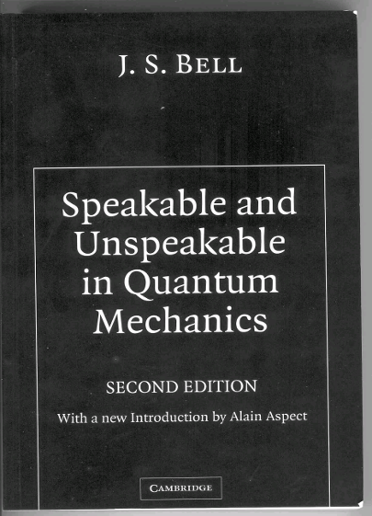
From Einstein’s intuition to quantum bits: a new quantum age?
Alain ASPECT - Institut d’Optique - Palaiseau
PITP Lectures on Quantum Phenomena
UBC Vancouver, May 25, 2012
AA: “Bell’s theorem: the naïve view of an experimentalist” quant-ph/0402001
AA: “John Bell and the second quantum revolution” in “Speakable and Unspeakable in Quantum Mechanics” (Cambridge University Press 2004).
CUP 2010
http://www.lcf.institutoptique.fr/atomoptic

Slide 2
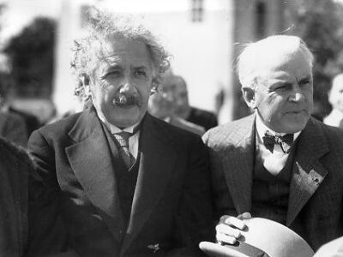
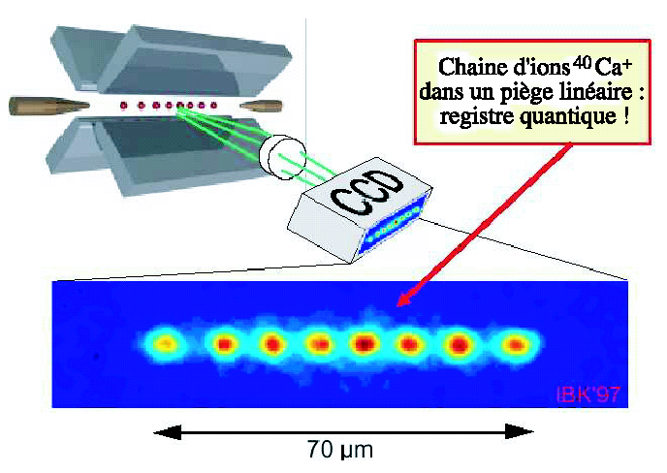
From Einstein’s intuitions to qubits
From Einstein-Podolsky
-Rosen to Bell
Experimental tests of Bell’s inequalities with correlated photons
A new quantum age?

Slide 3
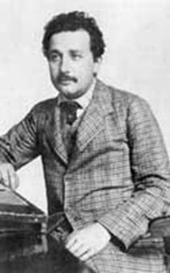
Einstein and quantum physics
A founding contribution (1905)
Light is made of quanta, later named photons, which have well defined energy and momentum. Nobel 1922.
A fruitful objection (1935): entanglement
Einstein, Podolsky, Rosen (EPR): The quantum formalism allows one to envisage amazing situations (pairs of entangled particles): the formalism must be completed.
Objection underestimated for a long time (except Bohr’s answer, 1935) until Bell’s theorem (1964) and the acknowledgement of its importance (1970-80).
Entanglement at the core of quantum information (198x-20??)

Slide 4
The EPR question
Is it possible (necessary) to explain the probabilistic character of quantum predictions by invoking a supplementary underlying level of description (supplementary parameters, hidden variables) ?
A positive answer was the conclusion of the Einstein-Podolsky-Rosen reasoning (1935). Bohr strongly opposed this conclusion.
Bell’s theorem (1964) has allowed us to settle the debate.
Notes:
Is it possible to explain…

Slide 5
The EPR GedankenExperiment with photons correlated in polarization
I
II
₊₁
a
b
₊₁
x
ν₁
ν₂
₊₁
S
y
z
₋₁
₊₁
₊₁
₋₁
Measurement of the polarization of ν₁ along orientation a and and of polarization of ν₂ along orientation b : results +1 or –1
Probabilities to find +1 ou –1 for ν₁ (measured along a) and +1 or –1 for ν₂ (measured along b).
Notes:
General view:

Slide 6
The EPR GedankenExperiment with photons correlated in polarization
I
II
₊₁
a
b
₊₁
x
ν₁
ν₂
₊₁
S
y
z
₋₁
₊₁
₊₁
₋₁
For the entangled EPR state…
Quantum mechanics predicts results separately random …
but strongly correlated:
Notes:
General view:

Slide 7
Coefficient of correlation of polarization (EPR state)
I
II
₊₁
a
b
₊₁
x
ν₁
ν₂
₊₁
S
y
z
₋₁
₊₁
₊₁
₋₁
Quantitative expression of the correlations between results of measurements in I et II: coefficient:
QM predicts, for parallel polarizers (a,b) = 0
Total correlation
More generally, for an arbitrary angle (a,b) between polarizers
Notes:
General view:

Slide 8
How to “understand” the EPR correlations predicted by quantum mechanics?
I
II
₊₁
a
b
₊₁
x
ν₁
ν₂
₊₁
S
y
z
₋₁
₊₁
₊₁
₋₁
Can we derive an image from the QM calculation?

Slide 9
How to “understand” the EPR correlations predicted by quantum mechanics?
Can we derive an image from the QM calculation?
The direct calculation
is done in an abstract space, where the two particles are described globally: impossible to extract an image in real space where the two photons are separated.
Related to the non factorability of the entangled state:
One cannot identify properties attached to each photon separately
“Quantum phenomena do not occur in a Hilbert space, they occur in a laboratory” (A. Peres) ⇒ An image in real space?

Slide 10
A real space image of the EPR correlations derived from a quantum calculation
b = a
2 step calculation (standard QM)
1) Measure on ν₁ by I (along a)
result +1
or
result −1
Just after the measure, “collapse of the state vector”: projection onto the eigenspace associated to the result
or
2) Measure on ν₂ by II (along b = a )
Easily generalized to b ≠ a (Malus law)
If one has found +1 for ν₁ then the state of ν₂ is
and the measurement along b = a yields +1;
If one has found −1 for ν₁ then the state of ν₂ is
and the measurement along b = a yields −1;
The measurement on ν₁ seems to influence instantaneously at a distance the state of ν₂ : unacceptable for Einstein (relativistic causality).

Slide 11
A classical image for the correlations at a distance (suggested by the EPR reasoning)
The two photons of the same pair bear from their very emission an identical property (λ) , that will determine the results of polarization measurements.
The property λ differs from one pair to another.
x
y
z
Image simple and convincing (analogue of identical chromosomes for twin brothers), but……amounts to completing quantum formalism:
λ = supplementary parameter, “hidden variable”.
Bohr disagreed: QM description is complete, you cannot add anything to it

Slide 12
A debate for many decades
Intense debate between Bohr and Einstein…
… without much attention from a majority of physicists
Quantum mechanics accumulates success:
  Understanding nature: structure and properties of matter, light, and their interaction (atoms, molecules, absorption, spontaneous emission, solid properties, superconductivity, superfluidity, elementary particles …)
  New concepts leading to revolutionary inventions: transistor (later: laser, integrated circuits…)
No disagreement on the validity of quantum predictions, only on its interpretation.

Slide 13
1964: Bell’s formalism
λ
λ
Consider local supplementary parameters theories (in the spirit of Einstein’s ideas on EPR correlations):
The two photons of a same pair have a common property λ (sup. param.) determined at the joint emission
The supplementary parameter λ determines the results of
measurements at I and II
at polarizer I
at polarizer II
The supplementary parameter λ is randomly distributed among pairs
at source S

Slide 14
1964: Bell’s formalism to explain correlations
λ
λ
An example
Common polarisation λ , randomly distributed among pairs
Quantum predictions
Result (±1) depends on the angle between λ and polarizer orientation (a or b)
Resulting correlation
Not bad, but no exact agreement
Is there a better model, agreeing with QM predictions at all orientations?
Bell’s theorem gives the answer

Slide 15
Bell’s theorem
No!
No local hidden variable theory (in the spirit of Einstein’s ideas) can reproduce quantum mechanical predictions for EPR correlations at all the orientations of polarizers.
Quantum predictions
Impossible to cancel the difference everywhere
Impossible to have quantum predictions exactly reproduced at all orientations, by any model à la Einstein
LHVT

Slide 16
Bell’s inequalities are violated by certain quantum predictions
Any local hidden variables theory ⇒ Bell’s inequalities
CHSH inequ. (Clauser, Horne, Shimony, Holt, 1969)
Quantum mechanics
a
b
For orientations
a’
b’
CONFLICT ! The possibility to complete quantum mechanics according to Einstein ideas is no longer a matter of taste (of interpretation). It has turned into an experimental question.

Slide 17
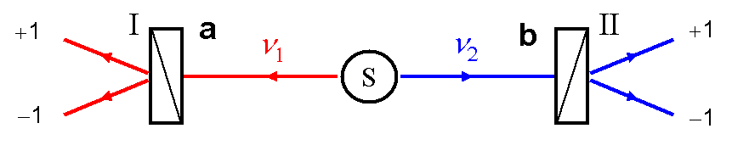
Conditions for a conflict
(⇒ hypotheses for Bell’s inequalities)
λ
λ
Supplementary parameters λ carried along by each particle. Explanation of correlations « à la Einstein » attributing individual properties to each separated particle: local realist world view.
The result of the measurement on ν₁ by I does not depend on the orientation b of distant polarizer II (and conv.)
The distribution of supplementary parameters over the pairs does not depend on the orientations a and b.
Bell’s locality condition

Slide 18
Bell’s locality condition
can be stated as a reasonable hypothesis, but…
…in an experiment with variable polarizers (orientations modified faster than the propagation time L / c of light between polarizers) Bell’s locality condition becomes a consequence of Einstein’s relativistic causality (no faster than light influence)
cf. Bohm & Aharonov, Physical Review, 1957
₊₁
I
a
b
II
₊₁
ν₁
ν₂
₊₁
S
₋₁
₊₁
₊₁
₋₁
L
Conflict between quantum mechanics and Einstein’s world view (local realism based on relativity).

Slide 19
From epistemology debates to experimental tests
Bell’s theorem demonstrates a quantitative incompatibility between the local realist world view (à la Einstein) –which is constrained by Bell’s inequalities, and quantum predictions for pairs of entangled particles –which violate Bell’s inequalities.
An experimental test is possible.
When Bell’s paper was written (1964), there was no experimental result available to be tested against Bell’s inequalities:
  Bell’s inequalities apply to all correlations that can be described within classical physics (mechanics, electrodynamics).
  B I apply to most of the situations which are described within quantum physics (except EPR correlations)
One must find a situation where the test is possible:
CHSH proposal (1969)

Slide 20
Three generations of experiments
Pioneers (1972-76): Berkeley, Harvard, Texas A&M
  First results contradictory (Clauser = QM; Pipkin ≠ QM)
  Clear trend in favour of Quantum mechanics (Clauser, Fry)
  Experiments significantly different from the ideal scheme
Institut d’optique experiments (1975-82)
  A source of entangled photons of unprecedented efficiency
  Schemes closer and closer to the ideal GedankenExperiment
  Test of quantum non locality (relativistic separation)
Third generation experiments (1988-): Maryland, Rochester, Malvern, Genève, Innsbruck, Los Alamos, Boulder, Urbana Champaign…
  New sources of entangled pairs
  Closure of the last loopholes
  Entanglement at very large distance
  Entanglement on demand

Slide 21


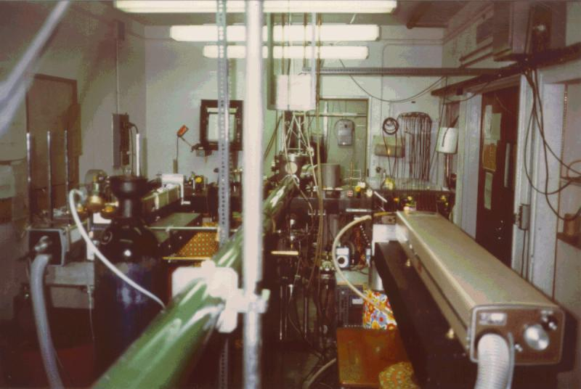
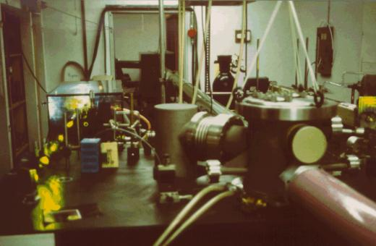
Orsay’s source of pairs of entangled photons (1981)
−1
+1
J = 1
0
Two photon selective excitation
☺ 100 coincidences per second
1% precision for 100 s counting
Polarizers at 6 m from the source: violation of Bell’s inequalities,
entanglement survives “large” distance
Pile of plates polarizer
(10 plates at Brewster angle)

Slide 22
Experiment with 2-channel polarizers (AA, P. Grangier, G. Roger, 1982)
Direct measurement of the polarization correlation coefficient: simultaneous measurement of the 4 coincidence rates

Slide 23
Experiment with 2-channel polarizers (AA, P. Grangier, G. Roger, 1982)
Measured value
± 2 standard dev.
Bell’s limits
Quantum mechanical prediction (including imperfections of real experiment)
Violation of Bell’s inequalities S ≤ 2 by more than 40 σ
Excellent agreement with quantum predictions S_{MQ} = 2.70

Slide 24
Experiment with variable polarizers AA, J. Dalibard, G. Roger, PRL 1982
Impose locality as a consequence of relativistic causality: change of polarizer orientations faster than the time of propagation of light between the two polarizers (40 nanoseconds for L = 12 m)
☹ Not realist with massive polarizer
Switch C₁ redirects light
☺ Possible with optical switch
either towards pol. in orient. a
PM
a’
b’
PM
C₂
or towards pol. in orient. a’
C₁
ν₁
ν₂
PM
S
PM
Equivalent to a single polarizer switching between a and a’
a
b
Between two switching:
Idem C₂ for b and b’

Slide 25
Experiment with variable polarizers: results AA, J. Dalibard, G. Roger, PRL 1982
Acousto optical switch: change every 10 ns. Faster than propagation of light between polarizers (40 ns) and even than time of flight of photons between the source S and each switch (20 ns).
Difficult experiment: reduced signal; data taking for several hours; switching not fully random
PM
a’
b’
PM
C₁
C₂
ν₁
ν₂
PM
S
PM
a
b
Convincing result: Bell’s inequalities violated by par 6 standard deviations. Each measurement space-like separated from setting of distant polarizer: Einstein’s causality enforced

Slide 26
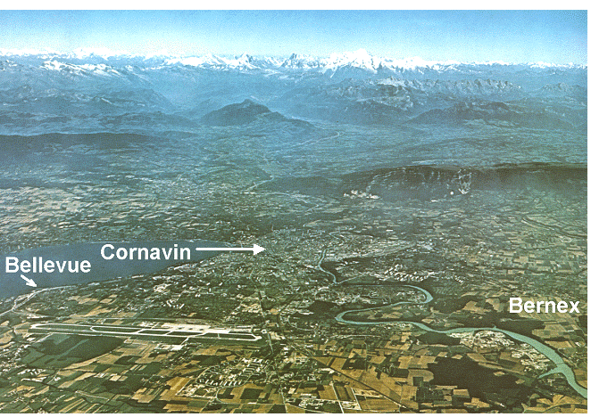
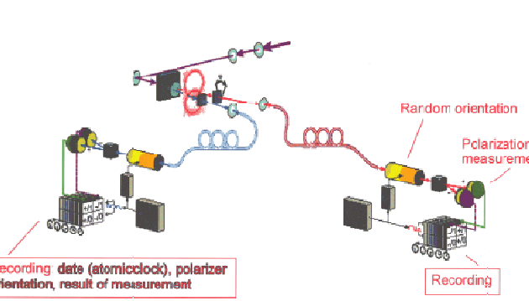
Third generation experiments
Entangled photon pairs by parametric down conversion,
well defined directions: injected into optical fibers.
Entanglement at a very large distance
Geneva experiment (1998):
Optical fibers of the commercial telecom network
Measurements separated by 30 km
Agreement with QM.
Innsbruck experiment (1998): variable polarizers with orientation chosen by a random generator during the propagation of photons (several hundreds meters). Agreement with QM.

Slide 27
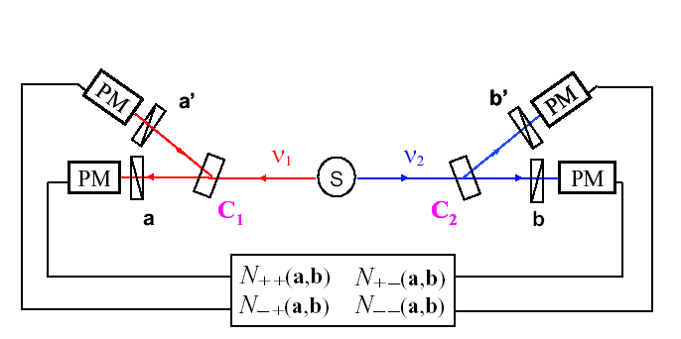
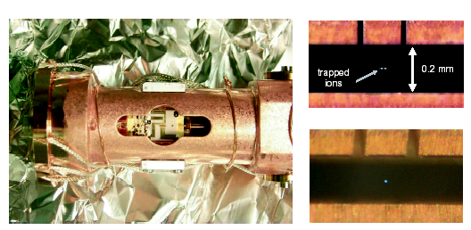
Bell’s inequalities have been violated in almost ideal experiments
Results in agreement with quantum mechanics in experiments closer and closer to the GedankenExperiment:
Sources of entangled photons
more and more efficient
Relativistic separation of
measurements with variable
polarizers (Orsay 1982,
Innsbruck 1998); closure of locality loophole
Experiment with trapped ions (Boulder 2000): closure of the “sensitivity loophole”.
Einstein’s local realism is untenable

Slide 28
The failure of local realism
Einstein had considered (in order to reject it by reductio ad absurdum) the consequences of the failure of the EPR reasoning:
[If quantum mechanics could not be completed, one would have to]
either drop the need of the independence of the physical realities present in different parts of space
or accept that the measurement of S₁ changes (instantaneously) the real situation of S₂
Quantum non locality – Quantum holism
The properties of a pair of entangled particles are more than the addition of the individual properties of the constituents of the pairs (even space like separated). Entanglement = global property.
NB: no faster than light transmission of a “utilizable” signal (ask!)
Notes:
Drop local realism

Slide 29
Entanglement: a resource for quantum information
The understanding of the extraordinary properties of entanglement and its generalization to more than two particles (GHZ) has triggered a new research field: quantum information
Hardware based on different physical principles allows emergence of new concepts in information theory:
  Quantum computing (R. Feynman 1982, D. Deutsch 1985 )
  Quantum cryptography (Bennett Brassard 84, Ekert 1991)
  Quantum teleportation (BB&al., 1993; Innsbruck 1997; Roma)
Entanglement is at the root of schemes for quantum information
Quantum cryptography (Ekert scheme)
Quantum gates: basic components of a “would be” quantum computer…
Quantum teleportation

Slide 30



Quantum Key Distribution with entangled photons (Ekert)
Alice and Bob select their analysis directions a et b randomly among 2, make measurements, then send publicly the list of all selected directions
Eve
ν₁
ν₁
ν₂
Entangled pairs
Alice
Bob
Cases of a et b identical : identical results ⇒ 2 identical keys
There is nothing to spy on the entangled flying photons: the key is created at the moment of the measurement.
If Eve chooses a particular direction of analysis, makes a measurement, and reemits a photon according to her result, his maneuver leaves a trace that can be detected by doing a Bell’s inequalities test.
QKD at large distance, from space, on the agenda

Slide 31
Quantum computing?
A quantum computer could operate new types of algorithms able to make calculations exponentially faster than classical computers. Example: Shor’s algorithm for factorization of numbers: the RSA encryption method would no longer be safe.
Fundamentally different hardware: fundamentally different software.
What would be a quantum computer?
An ensemble of interconnected quantum gates, processing strings of entangled quantum bits (qubit: 2 level system)
Entanglement ⇒ massive parallelism
The Hilbert space to describe N entangled qubits has dimension 2^{N} ! (most of that space consists of entangled states)

Slide 32
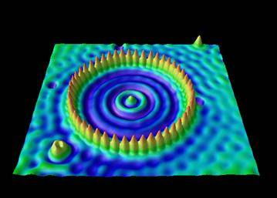
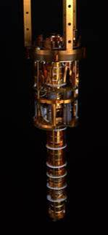
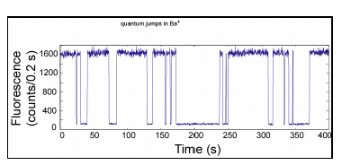
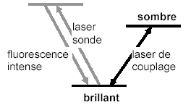
A new quantum age
Two concepts, at the root of a new quantum era
Entanglement
  A revolutionary concept, as guessed by Einstein and Bohr, strikingly demonstrated by Bell, put to use by Feynman et al.
  Drastically different from concepts underlying the first quantum revolution (wave particle duality).
Individual quantum objects
  experimental control
  theoretical description (quantum Monte-Carlo)
Examples: electrons, atoms, ions, single photons, photons pairs

Slide 33
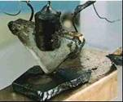
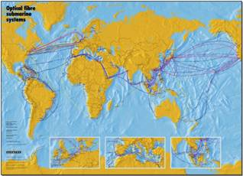
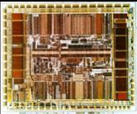
Towards a new technological revolution?
Will the new conceptual revolution (entanglement + individual quantum systems) give birth to a new technological revolution?
First quantum revolution (wave particle duality): lasers, transistors, integrated circuits ⇒ information society
Will quantum computers and quantum communication lead to the “quantum information society”?
The most likely roadmap (as usual): from proofs of principle with well defined elementary microscopic objects (photons, atoms, ions, molecules…) to solid state devices (and continuous variables?) …
A fascinating issue…
we live exciting times!

Slide 34


Acknowledgements
Thanks to the brave young* students whose involvement and enthusiasm were crucial to complete the 1982 experiments
Jean Dalibard
Philippe Grangier
to Gérard Roger and André Villing whose ingenuity made the Institut d’Optique experiment stable enough to produce reliable results
to those who encouraged me at a time when “Bell’s inequalities” was not a section of the PACS classification index
* (in 1981- 82)

Slide 35
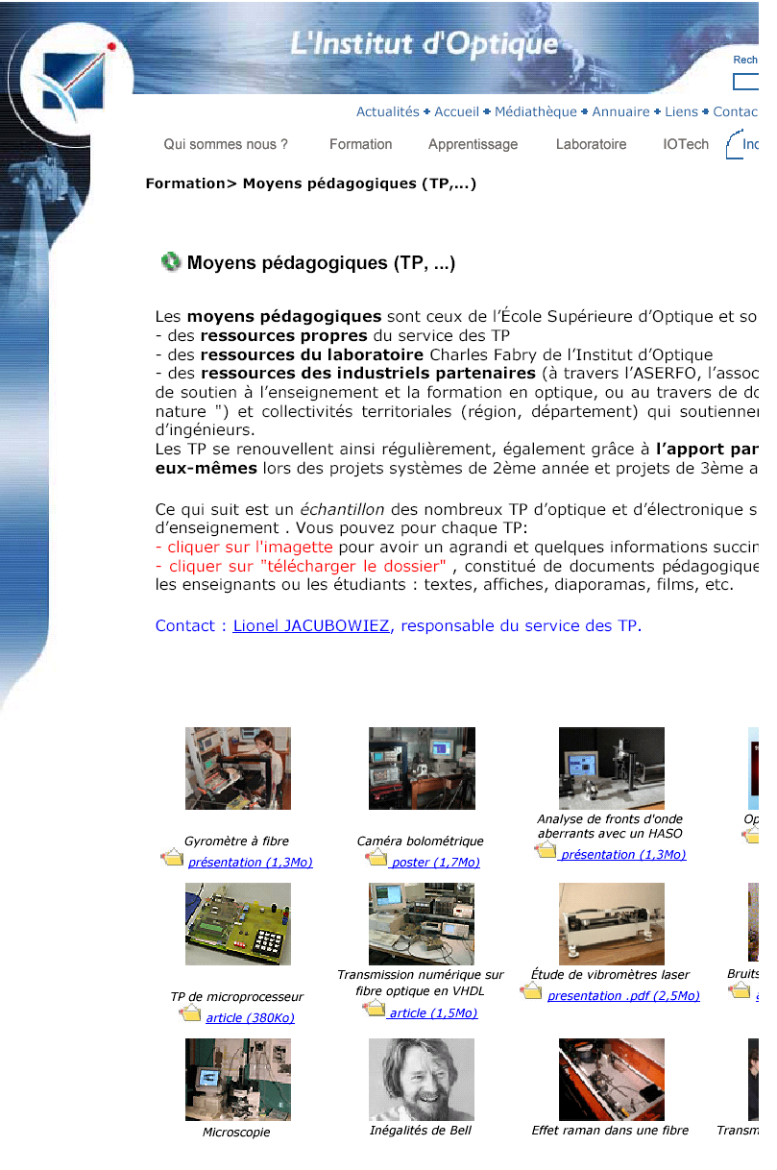
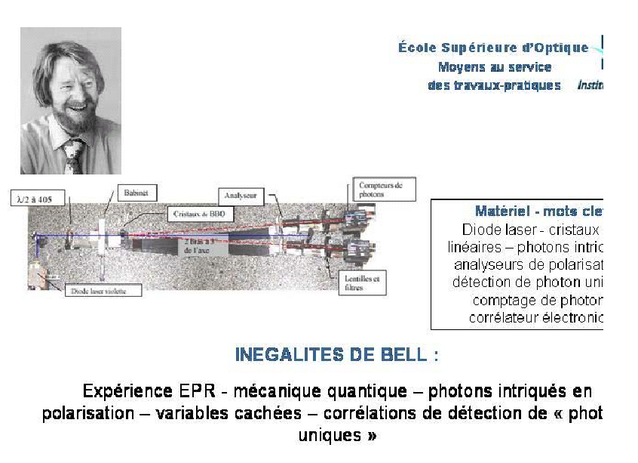
Bell’s inequalities at the lab classes of the
Institut d’Optique Graduate School
http://www.institutoptique.fr/telechargement/inegalites_Bell.pdf

Slide 36
Appendix
No faster than light signaling with EPR pairs

Slide 37
No faster than light signaling with EPR entangled pairs
₊₁
I
a
b
II
₊₁
ν₁
ν₂
₊₁
S
₋₁
₊₁
₊₁
₋₁
Alice changes the setting of polarizer I from a to a’: can Bob instantaneously observe a change on its measurements at II ?
Single detections:
No information about a
Joint detections:
Instantaneous change !
Faster than light signaling ?

Slide 38
No faster than light signaling with EPR entangled pairs
₊₁
I
a
b
II
₊₁
ν₁
ν₂
₊₁
S
₋₁
₊₁
₊₁
₋₁
Alice changes the setting of polarizer I from a to a’: can Bob instantaneously observe a change on its measurements at II ?
Joint detections:
Instantaneous change ! Faster than light signaling ?
To measure P₊₊(a,b) Bob must compare his results to the results at I: the transmission of these results from I to Bob is done on a classical channel, not faster than light.
cf. role of classical channel in quantum teleportation.

Slide 39
So there is no problem ?
₊₁
₊₁
I
a
b
II
ν₁
ν₂
S
₋₁
₋₁
View a posteriori onto the experiment:
During the runs, Alice and Bob carefully record the time and result of each measurement.
After completion of the experiment, they meet and compare their data…
… and they find that P₊₊(a,b) had changed instantaneously when Arthur had changed his polarizers orientation…
Non locality still there, but cannot be used for « practical telegraphy »

Slide 40
Is it a real problem ?
« It has not yet become obvious to me that there is no real problem. I cannot define the real problem, therefore I suspect there’s no real problem, but I am not sure there is no real problem. So that’s why I like to investigate things. »*
R. Feynman: Simulating Physics with Computers, Int. Journ. of Theoret. Phys. 21, 467 (1982)**
* This sentence was written about EPR correlations
** A founding paper on quantum computers
Notes:
Is it a real problem ,

Slide 41
It took a long time for entanglement to be recognized as a revolutionary concept
** A founding paper on quantum computing

Slide 42
Entanglement: a resource for quantum information
Beyond Bell’s inequalities violation: GHZ. Entanglement with more particles can lead even farther from classical concepts
Understanding the extraordinary properties of entanglement has triggered a new research field: quantum information
Hardware based on different physical principles can lead to new concepts in information theory:
  Quantum computing (R. Feynman 1982, D. Deutsch 1985 )
  Quantum cryptography (Bennett Brassard 84; Ekert 1991)
  Quantum teleportation (B, B, et al. 1993)
Spectacular experimental demonstrations of these schemes
Notes:
Everybody knows what Z stands for; Z has contributed in these 3 topics

Slide 43
Mathematically proven safe cryptography: sharing two identical copies of a secret key
The goal: distribute to two partners (Alice et Bob) two identical secret keys (a random sequence of 1 and 0), with absolute certainty that no spy (Eve) has been able to get a copy of the key.
Using that key, Alice and Bob can exchange (publicly) a coded message with a mathematically proven safety (Shannon theorem) (provided the message is not longer than the key)
Eve
110100101
110100101
Alice
Bob
Quantum optics provides means of safe key distribution (QKD)

